Slide 1

Lecture 3.
Symmetry breaking
Degenerate ground states
Solitons in 1D systems
Higher dimensions.

Slide 2


Tidal wave
Tsunami coming
Tidal wave
Solitons in general : propagating isolated profiles –
from the tsunami wave (Russel 1834) to
magnetic domain walls and to hypothetic
holons and spinons in strongly correlated systems

Slide 3
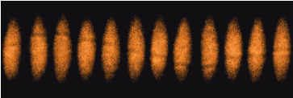
The most opposite exemple: Heavy solitons in a
fermionic superfluid of optically trapped ultra-cold atomic gases.
M.W. Zwierlein, MIT
“We create long-lived solitons in a strongly interacting superfluid of fermionic atoms and directly observe their motion.”

Slide 4
Microscopic solitons in quasi-1D
electronic systems with symmetry breakings:
Born in theories of late 70’s, Guessed in experiments of early 80’s,
Persuading observations in 2000’s, Visualization in 2010’s
Why the resent explosion of interest ?
New optically and electronically active polymers,
New ferroelectric Mott state in organic conductors.
New STM and tunneling observations in Charge Density Waves.
New high magnetic field access to spin polarized FFLO-like states
of CDW, superconductor, and the spin-Peierls state.
further new area:
Transformations of symmetry broken electronic states by
impacts of optical pumping and electrostatic field effect doping.

Slide 5
Topics - for today:
Systems with attraction – CDWs and superconductors.
Selftraping of electrons into amplitude solitons.
Confinement of solitons.
Spinons as solitons, experiments:
visualization by STM and identification in tunneling.
Optics of solitons and polarons.
For another lecture: Electronic systems with repulsion.
Introduction to the 1D Mott state, holons.
Organic conductors:
Charge ordering, ferroelectricity, firework of solitons,
cases of spin-charge reconfinement,
Optics experiments and enigmas,
role of lattice deformations.
Quasi-1D route to D>1 AFM Mott state.

Slide 6
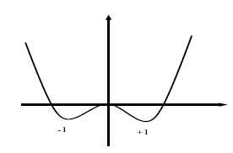
Landau theory of phase transitions with symmetry breakings
1-component =“real” order parameter :
Ferroelectrics, uniaxial easi-axis ferromagnets, lattice dimerizations.
Static states – minima of
W
a>0 , h=c=0
Metastable
Stable state

Slide 7
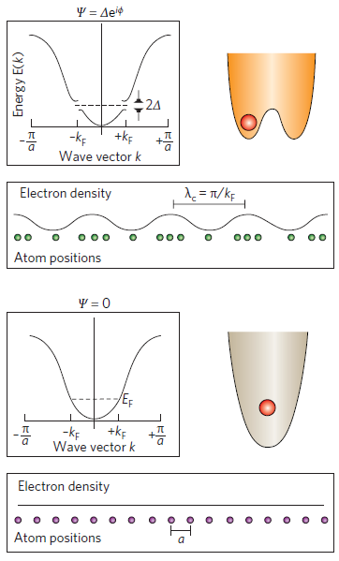
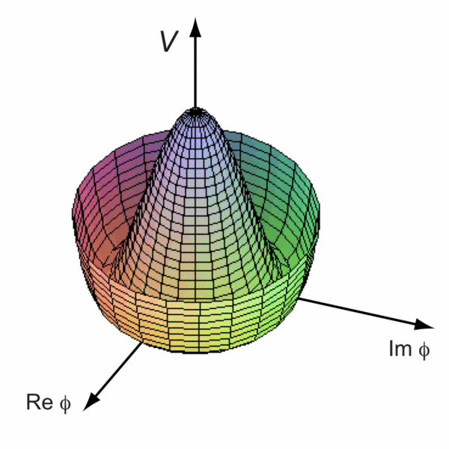
Two-component or “complex” order parameter,
the vector (u,v) of the complex field Ψ=u+iv=Aexp(iφ):
Easy-plane ferromagnets,
Bose-condensates,
superconductors, Incommensurate
charge density waves ICDW.
ICDW order parameter:
O_{CDW} ~Acos(Qx+ϕ)
A – amplitude ϕ - the phase
ISDW order parameter:
O_{SDW} ~m cos(Qx+ϕ)
m – staggered magnetization vector

Slide 8
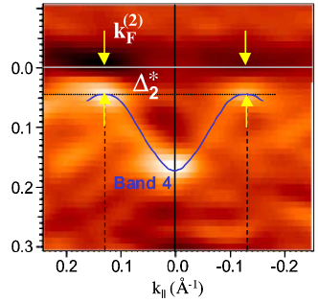
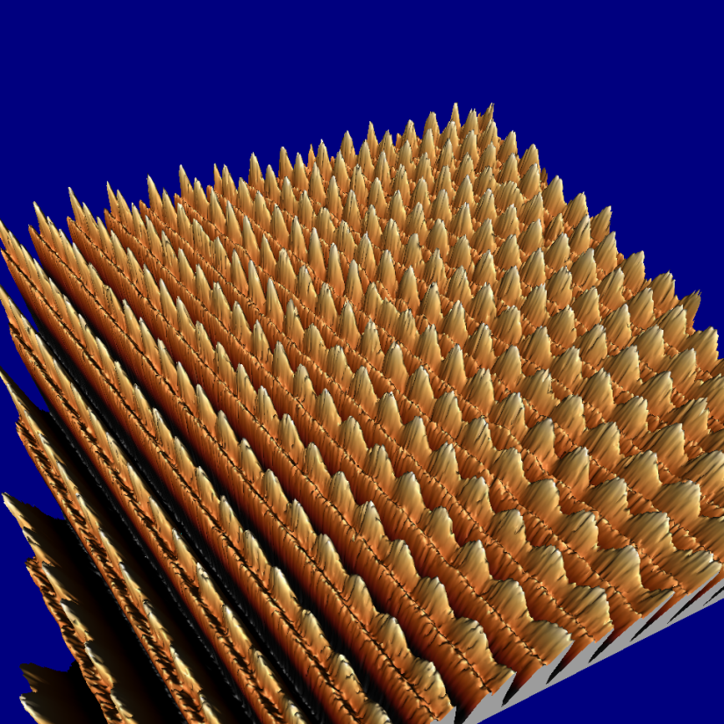
Incommensurate, 3D ordered Charge Density Waves - CDW
ARPES gives electrons’ spectral density, hence E(k) with the gap Δ
formed by the CDW
CDW
wave
fronts
Scanning Tunneling
Microscopy STM shows
the CDW modulation in
atomic displacements
and the electronic density.
Brun, Wang, Monceau, SB
chains

Slide 9
Electrons with a weak repulsion can form the spin density wave - SDW self-consistently, modulating their charge or spin density.
CDW: Q=2k_{F} mixes –k_{F}↑ and k_{F}↑ ; –k_{F}↓ and k_{F}↓
SDW: Q=2k_{F} mixes –k_{F}↑ and k_{F}↓ ; –k_{F}↓ and k_{F}↑
SDW is the case of many organic metals and the special case of cromium
Both CDW and SDW are electronic crystals with 2 electrons per unit cell.
At first sight, they are insulators by general principles of band theory, even if the bands are formed by a spontaneous symmetry breaking.
But this degeneracy brings to life new ingredients:
collective modes and solitons.

Slide 10
Peierls Instability and Charge Density Waves (CDW):
metallic
transition in 1-D
2 electrons in a period
The wave length is not related
to the original cell size → possibility for the incommensurate CDW - ICDW
insulating
Energy profile as function
of the complex order parameter

Slide 11
E
-2k_{F}
E
2k_{F}
2k_{F}
2k_{F}
ε_{F}
-π/2a
π/2a
-k_{F}
k_{F}
Half-filled band,
CDW of dimerization,
single-component
order parameter
Fractional filled of the band,
incommensurate CDW ,
two-component = complex
order parameter

Slide 12
Solitons in perspective of quasi-1D electronic systems
Self-localized excitations exploring degeneracies of ground states
with a spontaneously broken symmetry:
superconductor, CDW, SDW, charge-order Mott insulator, electronic ferroelectric.
Solitons carry spin and/or charge – separately, even in fractions.
They bring associated spectral features
(electronic mid-gap states, vibrational modes)
They can take over normal electrons as charge or spin carriers.
They give definitions of holons and spinons in correlated systems.
Instantons : related transient processes for creations of solitons or their pairs, for conversion of electrons or excitons into solitons
Symmetry breaking :
degenerate equivalent
ground states.
simplest soliton=
trajectory between them

Slide 13
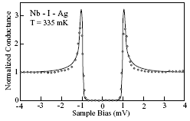
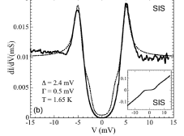

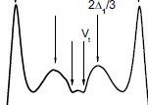
Singlet ground state gapful systems:
SuperConductors SCs and
Charge Density Waves CDWs.
Standard BCS-Bogolubov view:
Spectra : E(k)= ±(∆²+(v_{f}k)²)^{1/2}
States = linear combinations of :
electrons and holes at ±p for SC
electrons at –p and p+2p_{f} for CDW
CaC₆
pair-breaking gaps from
tunneling experiments.
Is it always true?
Proved “yes” for typical SCs.
Questionable for strong coupling : High-T_{c},
real space pairs, cold atoms, bi-polarons.
Certainly incomplete for CDWs
as proved by many modern experiments.
Certainly inconsistent for 1D and even
quasi 1D systems as proved theoretically.
NbSe₃
Guilty and Most Wanted : solitons and their arrays.

Slide 14
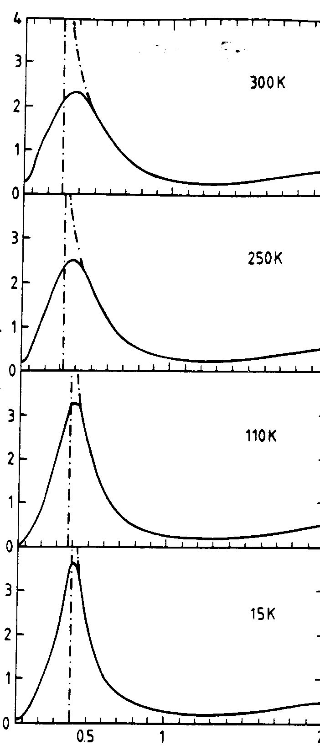
The gap interval (-Δ, Δ) may become partly filled by:
Absence of the true long range order
(the pseudogap),
Anomalous lower energy excitations
- solitons
Pseudogaps in tunneling and optics

Slide 15
Topological defects on the polyacethylene chains
W
Ideal chain
Δ
Δ₀
0
-Δ₀
Q=+e
Charge solitons
q=±e, s=0
Δ₀
0
Q=-e
-Δ₀
Δ₀
Spin soliton,
q=0, s=1/2
0
-Δ₀
Δ=Δ₀ tanh [x/ξ₀], W_{tot} = (2/π)Δ₀ E_{el} =0

Slide 16
Solitons and polarons at an isolated (CH)_{x} chain
Split-off intra-gap bound states at levels ±E_{b}
Spontaneous symmetry breaking gives rise to solitons –
kinks between domains of opposite dimerizations.
In PA they are identified by spectroscopy and ESR.
Specific to PA
Δ
−Δ
E_{b} =0
Spinless solitons would be favorite charge carries for unperturbed chain.
Δ
Δ
non-specific
The higher energy Polarons (charge e, spin ½) enter the game
thanks to Coulomb attraction from charged dopants.

Slide 17
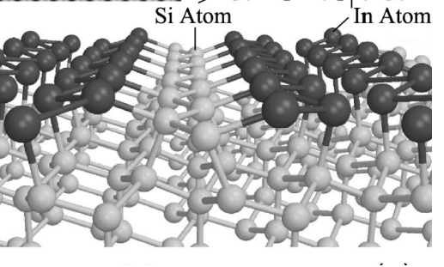
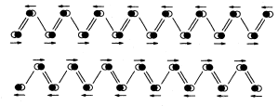
Observation of a soliton in a truly 1D physics, Han Woong Yeom, Pohang
The array of Indium chains at Si 111 surface.
Ground state: 2-fold commensurate CDW, discrete Z₂ symmetry of dimerization. Realization of the Gross-Neveu model and KdV.
E
E
E_{F}
-k_{F}
k_{F}
-k_{F}
k_{F}

Slide 18
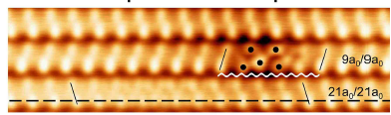
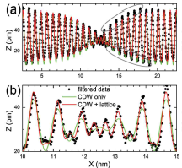
Strong defect immobilizes
the soliton at a below chain
Excellent fitting similar to NbSe3
with ξ= 3.4 nm=9a
Amplified central view
Hopping of solitons’ was noticed – mobile intrinsic defect !

Slide 19
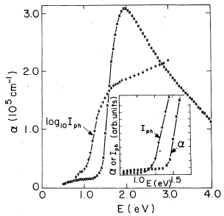
Back to Polyacetylenes
Photo-current, hence the photo-conductivity,
comes only from excited unbound pairs at E>E_{g}
Absorption – also from bound excitons, hence expect a
lower threshold at E_{ex}<E_{g} as it is normally observed.
The photocurrent I_{ph} offset
starts below the absorption !
I_{ph} is much more sensitive, it recovers
adiabatically forbidden creation
of relaxed configurations –
here pares of solitons.
Their threshold is, theoretically, 30% lower.
In favor of that: exponential growth of I_{ph}.

Slide 20
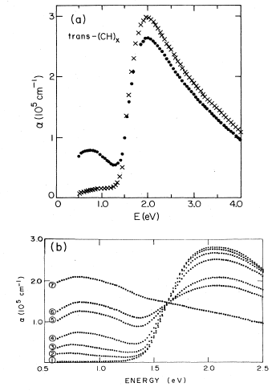
Metallization under doping
Low doping: gap is preserved,
Mid-Gap and IR activities appear
Larger doping:
No more gap seen,
all absorption goes to IR
Metallization in (CH)_{x} starts at x=1% of dopping, ends up at 10% - enormous concentration, distance 10^{1/3} ~2-3 units,
effect of one-dimensionality!
Only the impurity along the chain at 10-100 units is seen for hopping.
Metallization in Si, etc
n=10¹⁸/cm³ ->
x=10⁻⁶/per Si,
distance 100 units

Slide 21
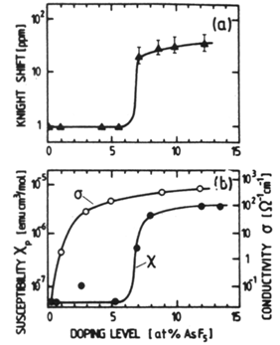
Doped polyacetylene (Y.W. Park):
Two steps to become a metal,
First hint to existence of solitons
conductivity σ and magnetic susceptibility χ
The major puzzle:
spins appear at much higher doping than the metallic conductivity:
whole interval of conduction by spinless – unlike electrons – particles.
That and many other propertiese showing up in NMR, ESR, optics
have brought the solitons to the sight of experiments

Slide 22
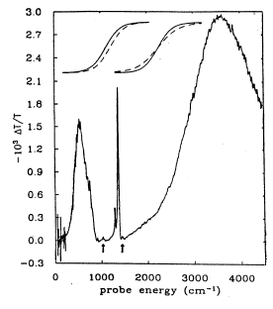
Two modes for vibration of
a soliton pinned by impurity.
Displacement as a whole -
Polar mode, optically active –
can absorb the light in IR.
Stretching-compression mode,
Non-polar, optically inactive –
cannot absorb the light, but
it is Raman active –
can scatter the light
with a loss of energy
IR photo-induced absorption in PA.
Arrows – new lines under pumping.
One is almost extinct –
it will be reversed in Raman spectra.

Slide 23
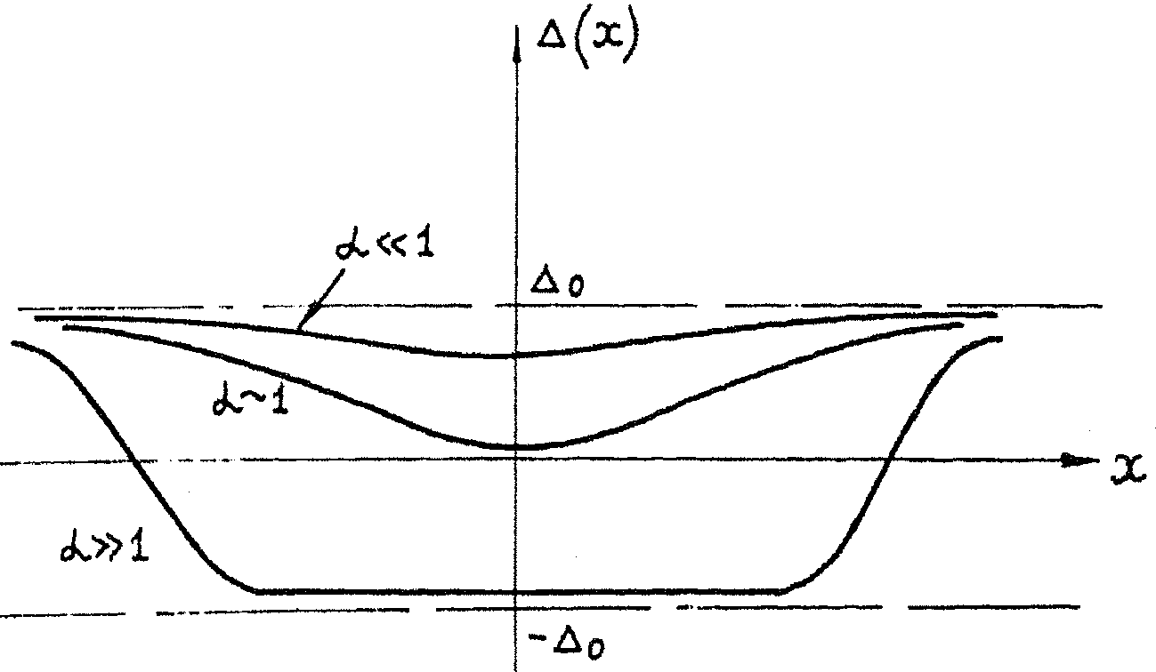
Topological protections: the only way to create solutions in the bulk
– make diverging kinks from selftrapping of a ee or hh or eh pair
Intragap levels of
developing bound state
Δ
E_{b}
0
-E_{b}
−Δ
One trapped electron –
stable intermediate position
Two trapped electrons –
diverging pair of kinks

Slide 24
Exact shapes:
equilibrium polaron (upper thick line);
pair of solitons with E=0.01) (lower thick line).
Thin lines - exact shapes of optimal fluctuations:
necessary to create these states by tunneling.
Their shapes are much less pronounced in comparison with
the final states which facilitates the tunneling.

Slide 25
Polaron
Intragap levels
of bound state
created by the polaron
Δ
E_{b}
0
-E_{b}
−Δ
Polaron energy :
Almost compensated gain and cost of energies

Slide 26
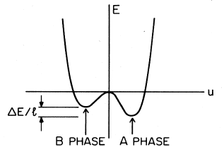
Most drastic effect upon kinks:
global lifting of symmetry - confinement.
Nature present -- cis-isomer of (CH)_{x} :
build-in slight inequivalence of bonds
hence lifting of ground state degeneracy,
hence confinement of solitons
Cis-(CH)_{x} :
Nonsymmetric dependence
of GS energy on dimerisation
Confinement – the linear growth of the attraction energy while the particle diverge.
Ideal chain
Energy difference per unit length
is a constant confinement force F.

Slide 27
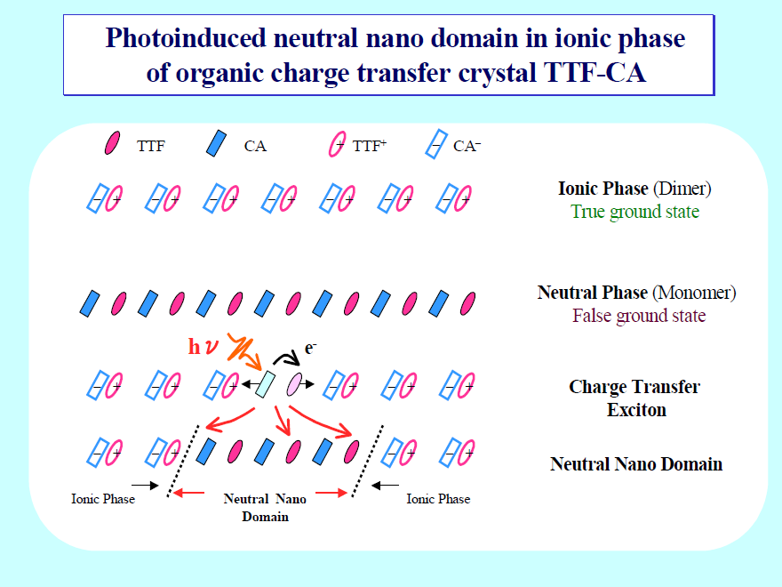
Common picture: phase transitions via formation of strings and walls.
The embedding of a foreign domain requires for an energy ~ its length
- unless exactly at the temperature of the 1st order phase transition where both phase have the same energy density.

Slide 28
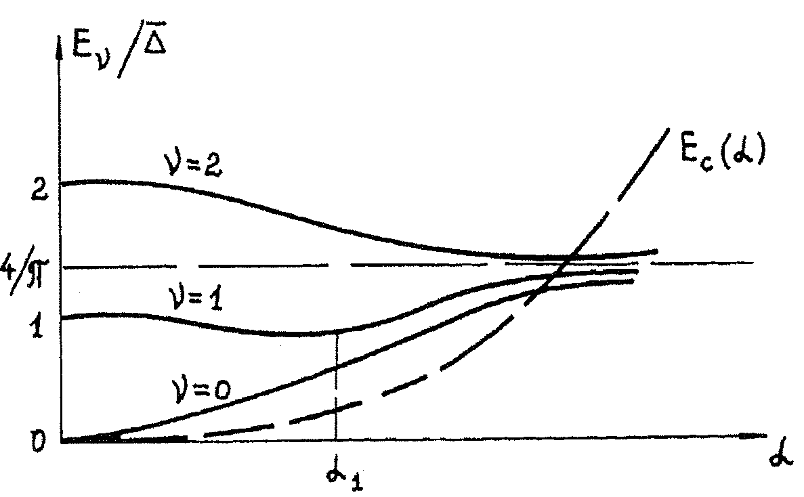
2 kinks cannot diverge far away anymore.
They form a loose bound state –
a particle with the charge 2e - the bipolaron
New ingredient –
confinement energy

Slide 29
Confinement of kinks pair into 2e charged (bipolaron)
or neutral (exciton) compex.
Symmetry determined picture of optical differences for
trans- and cis- isomers S. B. and N. K.
Photoconductivity trans-(CH)_{x} vs photoluminescence cis-(CH)_{x}
also new optical features due to hybridization of mid-gap states

Slide 30
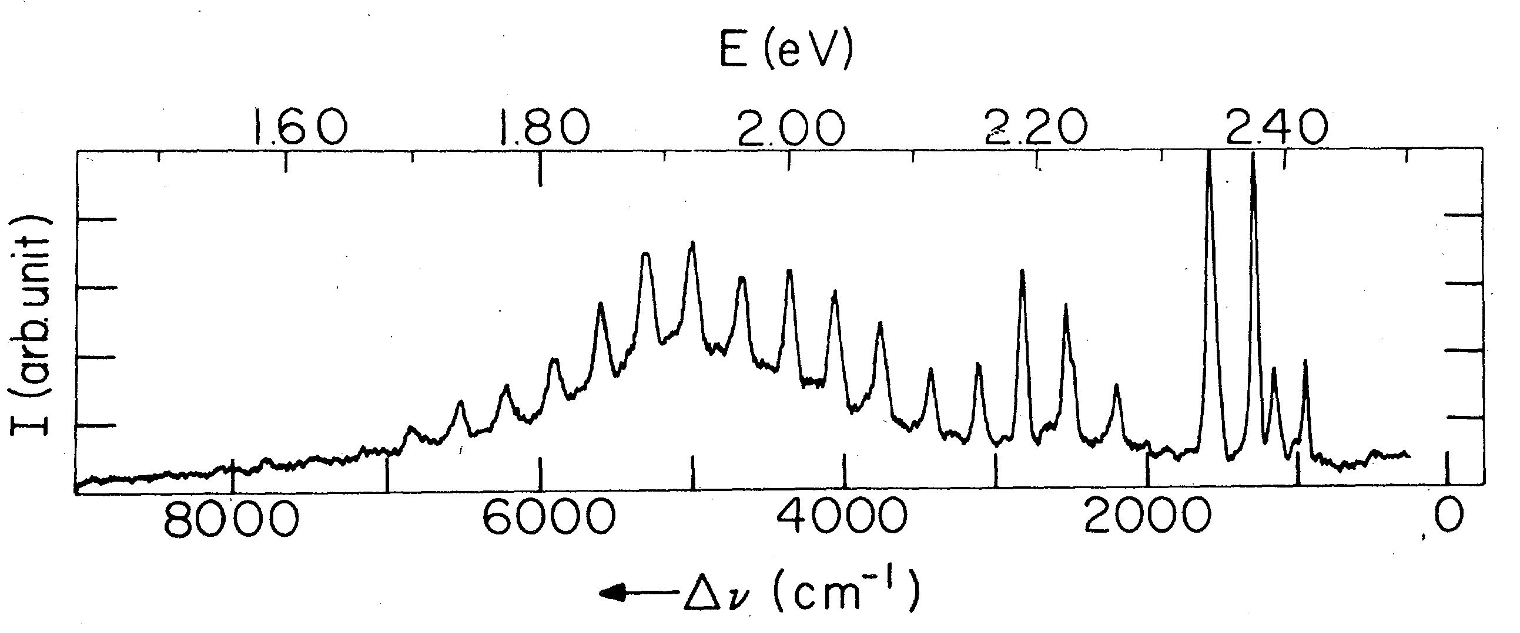
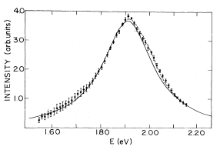
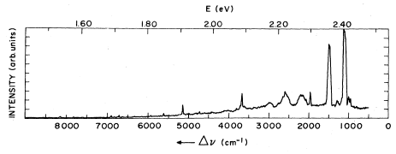
Only luminescence of cis-(CH)x vs only photoconductivity
In trans- (CH)x
Same data, just
cleaned from phonons
Broad line covered by multiple phonons
repetitions - vibrations of the lattice dressing
of the selft-traped state
- additional proof of the selftrapping.
trans-PA, T=7K, pump at 2.54eV
Remnant luminescence is
50 times less then that of cis-PA

Slide 31

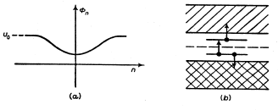
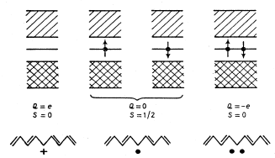
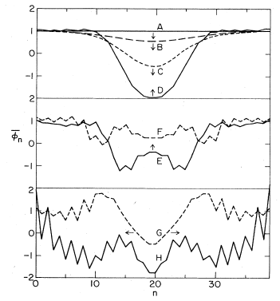
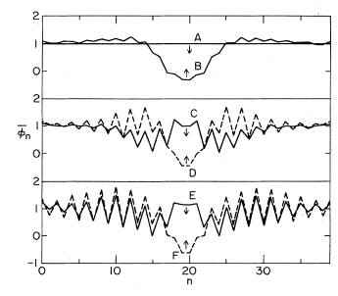

Slide 32
How do we identify bipolarons?
In optics by specific lines appearing under doping or even (?) pumping.
ESR under low-to-moderate doping to detects no spins
Clear evidences that BPs function as the main reservoir for charge storage
- generalize to junctions, to field-effect transistor!
No clear proof that BPs can conduct as individual 2e particles
– would be a step towards the superconductivity –
activation into polarons may be necessary.

Slide 33
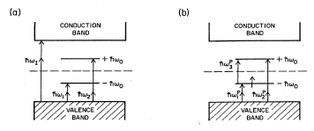
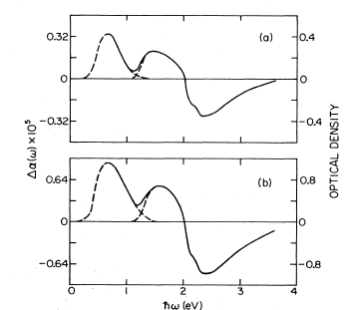
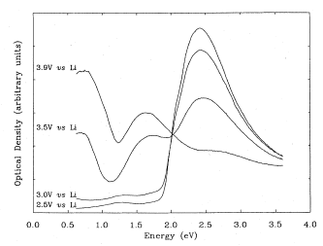
Energy schemes for
a) 2-h bi-polaron – 2 transitions
b) 1-h polaron – 3 transitions.
Both split inside the gap a symmetric pair of levels –
viewed as splitting of the zero-energy state in PA
One of transitions is optically forbidden,
hence expect 1 transition for BPs and 2 transitions for Ps

Slide 34
How do we identify polarons?
In optics by specific lines appearing under doping and pumping –
proving their similarity.
Doing ESR under low-to-moderate doping to detect the spins.
Doing combined experiments for ESR under optical pumping.
In kinetics, beyond the internal optical transitions,
the polarons are like electrons or holes,
just ~10⁰ times more heavy, hence the reduced mobility, enhanced binding to dopants, impurities.

Slide 35
Combination of the techniques of the photoinduced absorption (PA)
and of the PA-detected magnetic resonance (PADMR).
Two spin 1/2 polarons will produce pairs with spins either parallel (sp) or antiparallel (sap).
For non-geminate e-h pairs, both sp and sap pairs will form initially,
but the recombination rate of sap pairs is higher, leading to steady state populations with sp.
MW-induced spin flips convert sp pairs into sap pairs,
increasing the recombination rate of oppositely charged pairs to the ground state and reducing polaron populations –
to be detected by the photoinduced absorption .
Magnetic resonance will also enhance bipolaron formation
from like-charged pairs.

Slide 36
3D reality: interchain interactions - confinement force F≈2×10⁵V/cm
Neglecting the Coulomb repulsion
(suppose two donors sit nearby as counter-ions)
the BPs are always more favorable than two electrons and even two polarons.
But taking them away from the donors
(attempt to make conduction by BPs)
turns on the Coulomb repulsion between the two electrons.
Confinement scenario :
the BP is a string between the two kinks at a distance x:
the BP energy, with respect to two bare electrons is
δW_{bp}=W_{bp}(x)-2Δ=-(2Δ-2W_{s})+F|x|+e²/(ε|x|)
- always an optimal x: δW_{bp}=-0.6Δ+2(Fe²/ε)^{1/2}
– favorable for small enough confinement force F.

Slide 37
3D reality: interchain interactions - confinement force G≈2×10⁵V/cm
Neutral phase of trapped polarons P
ξ
Δ
Δ
Δ
Neutral phase of trapped deconfined solitons DS
Δ
ξ
−Δ
−Δ
L
Ionic phase: deconfined bi-solitons (q=2e) occupy half of the dopants
Δ
−Δ
−Δ
x

Slide 38
Tunneling conduction by transformations polaron -> bisoliton
Two trapped polarons. Transfer of the bound electron at E_{b} < Δ.
Confinement energy EL gain gain against repulsion U cost.
E
Emptified polaron shell vanishes
leaving the nude dopant
Overcharged polaron shell
evolves into divergent solitons
creating the CS complex at one dopant.
Energy gain by evolving the intragap energy
from E_{b}=0.7Δ for polaron to E_{b} -> 0 for solitons compensates for
the e-e repulsion cost facilitating the tunneling.

Slide 39
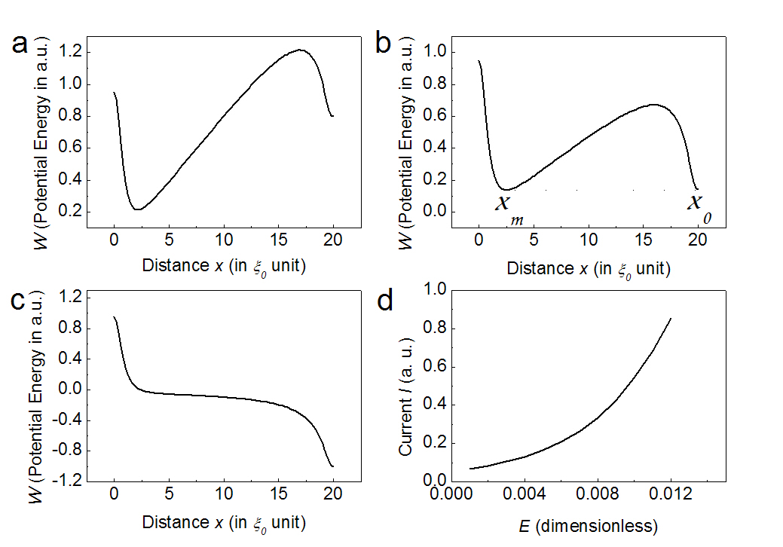
Conduction by tunneling deconfinement of solitons
Confined ionic
tunneling deconfinement
G>e²/ξL
e²/L² < G < e²/Lξ
deconfined
G<e²/L²
tunneling I-V

Slide 40
In the lightly doped crystalline polyacetylene,
three phases are possible:
neutral polaronic phase, neutral solitonic phase, ionic bi-solitonic phase.
Electric field erases the confinement force providing the crossover between different phases.
At low electric field, charge carriers are polarons,
giving rise the magnetoresistance.
At high electric field – the crossover from neutral polaronic phase to the neutral phase ofdeconfined solitons
(possibility via confined ionic phase),
hence vanishing magnetoresistance.
Tunneling deconfinement gives the nonlinear I-V in the spinless regime.
Tunneling conversion of polarons into confined pair of solitons gives the nonlinear I-V in the spinful regime of the nonlinear magnetoresistance.

Slide 41
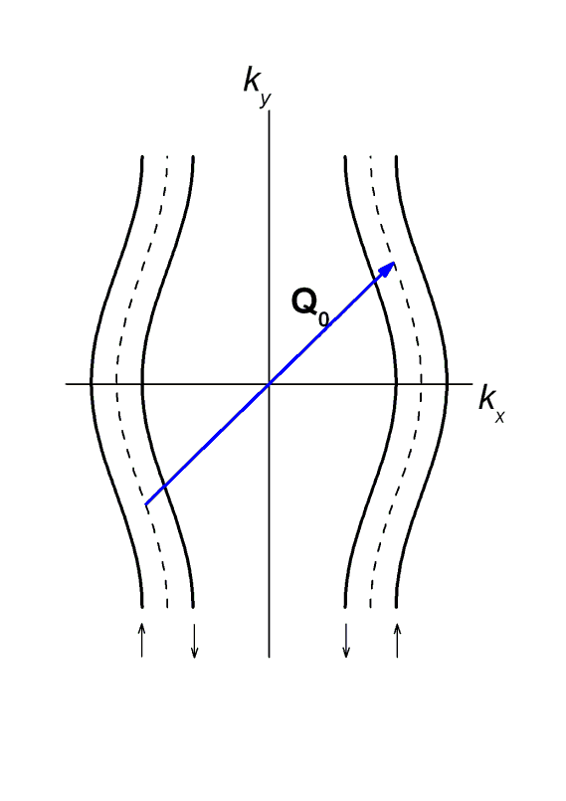

CDW in a magnetic field
Pauli paramagnetic effect: suppresses CDW [W. Dieterich & P. Fulde, 1973]
Phase diagram of
α-(BEDT-TTF)₂KHg(SCN)₄
2μ_{B}B/hv_{F}
B
Q₋
CDW_{x}
NM
~ 23 T
Q₊
CDW₀
Beatings between close, Zeeman splitted, CDW wave numbers Q₋ and Q₊ give rise tothe array of domain walls
– spin carrying solitons
T_{CDW}/T_{CDW}(0)

Slide 42
Arrays of amplitude solitons (Fulde, Ferrel, Lakin, Ovchinnikov) unit for spin-polarized superconductors
Unit of CDW superstructure in HMF (new experiments on organics).
Soliton lattice unit in spin-Peierls systems in magnetic field
(NMR, neutrons – C. Berthier et al, Grenoble; J.P. Pouget et al).
Very new (Orsay – Jerome, Pasquier, S.B., et al):
Solitonic lattice as a support for superconductivity near
SDW insulator-metal transition
CDW or SC under slightly supercritical Zeeman splitting. plotted:
Solitonic lattice of the order parameter,
Unpaired spins = mid-gap states density distributed near the gap zeros.
If melted, each element becomes a particle - Amplitude Soliton = Spinon
1
0
-1
Equivalent picture in Peierls systems:
charged spinless solitons introduced by dopping or field effect
SB, Gordunin, Kirova

Slide 43
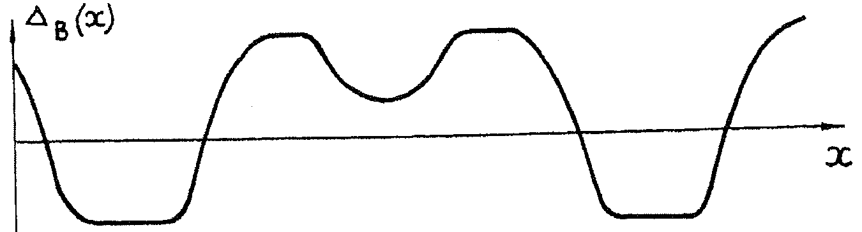
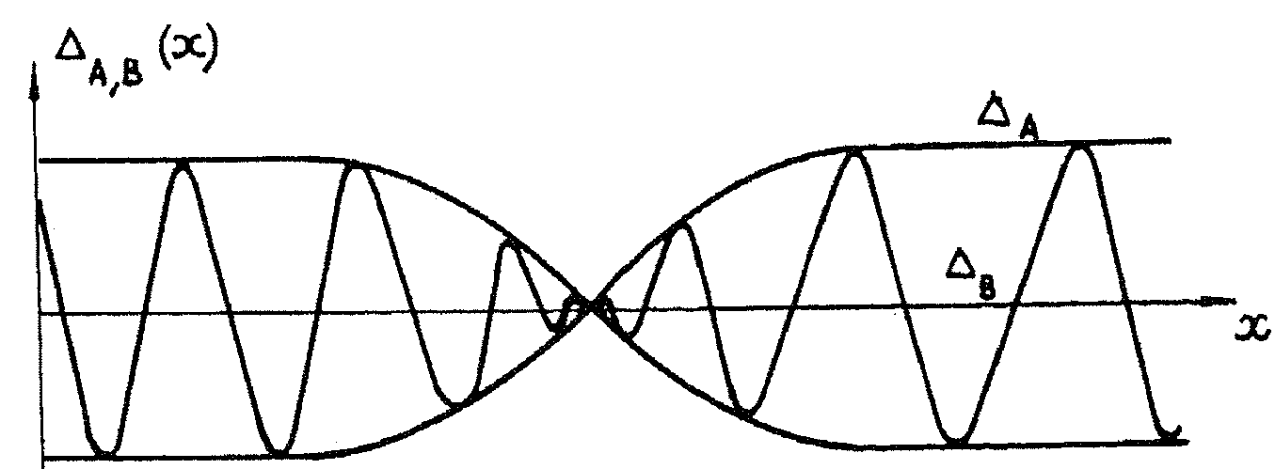
Combination of charge doping and spin injection:
Soliton upon a periodic structure: two limiting regimes.
Soliton embedded into a rare array of waves
Surfers’ hunt: Overlapping soliton modulates sequence of waves.
Whatever regime or soliton’s position, the array shift across
the soliton is always half of the period . The soliton is topologically nontrivial but is not topologically stable. It is stable energetically accommodating the unpaired spin ½ at the split off level.
The charge is variable: evolves from e to zero.
SB, Dzyaloshinskii, Kirova

Slide 44
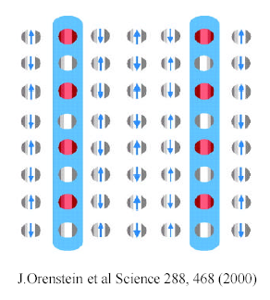
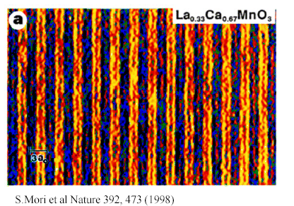
Inverse rout: from stripes to solitons
1D → quasi 1D → 2D,3D route to dopping of AFM insulator.
Aggregation of holes (extracted electrons) into stripes.
Left: scheme derived from neutron scattering experiments.
Right: direct visualization via electron diffraction microscope.
Equivalence for spin-gap cases:
Fulde-Ferell-Larkin-Ovchinnikov FFLO phase in superconductors
Solitonic lattices in CDWs above the magnetic breakdown
Solitonic lattices in spin-Peierls GeCuO in HMF - Grenoble

Slide 45
CASES OF CONTINUOUS DEGENERACY
Limitation of the above cases of discrete symmetry breaking :
Solitons can be created only in pairs, even in 1D.
In D>1 they are either permanently confined in pairs
or aggregated into macroscopic domain walls.
A higher continuous degeneracy -
superconductors, SDWs, incommensurate CDWs -
allows for existence and creation of isolated solitons,
of direct conversion of a single electron into a single soliton.
In 1D, a single electron becomes unstable with respect to its selftrapping - transformation into a soliton.
In D>1 an undressed electron is metastable,
hence both particles may be observed simultaneously

Slide 46
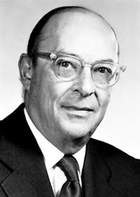
John Bardeen’s Grand Unification:
……
1940’s - transistor
1950’s - Superconductivity
1976 – 30/01/1991- - Charge Density Waves
Common features of incommensurate CDWs and the superconductors:
O_{cdw} =Acos(2K_{F}x+ φ) → complex order parameters
O_{cdw,sc} ~ A exp[iϕ]
hence vortices ←→ dislocations, phase slips ←→ phase solitons
Similar microscopic theories: Peierls-Frohlich vs BSC
Pair-breaking gaps 2Δ , hence tunneling, FFLO ←→ solitonic lattices
Tighter links at D=1:
The phases ϕ_{cdw} , ϕ_{sc} are in conjugation: [ϕ_{i}, ∂_{x}ϕ_{j}]~δ(x)
2Δ becomes the common spin gap; broken pair becomes 2 free spinons.
Spinons as amplitude solitons

Slide 47
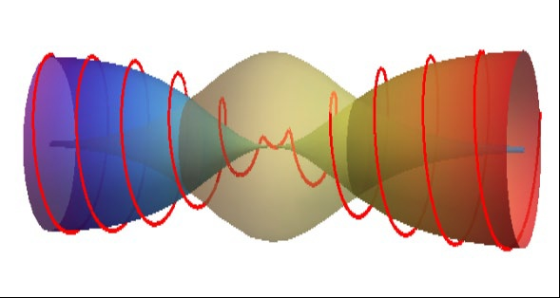

Complex order parameter , Incommensurate CDWs.
Noninteger variable charges.
Modeling for the amplitude π-soliton = spinon in the CDW
Localisation of the
self-trapped electron
(A,ϕ) trajectory of the CDW order parameter Acos(Qx+ϕ)
This is the state of a 1D CDW or 1D superconductor
with one added unpaired electron.
Solitons are stable energetically but not topologically.
Special significance:
allowance for a direct transformation of
one electron into one soliton.
(Only 2→2 allowed for dimerization kinks)

Slide 48
Add a single electron or hole near the gap rims, ±Δ₀, allow for deformations of the gap: amplitude Δ=Δ₀+δ and phase  d /dx= ’ .
Check for stability:
Topological soliton !
Charge of trapped electron
is exactly compensated

Slide 49
Precisions from exact solutions
family of chordus solitons
Δ
2
V₁
2π
SOLITON
θ
E
V₂
2θ
E
-
Sequence of chordus solitons develops from bare θ=0 through
the amplitude soliton at 2θ=π to the full phase slip 2θ=2π.
Intra-gap split-off state E evolves from Δ₀ to -Δ₀ providing spectral flow across the gap together with the electrons’ conversion.
V_{n}(θ) - selftrapping branches of the total energy for chordus solitons with
the intragap state fillings n =1 and n=2.

Slide 50
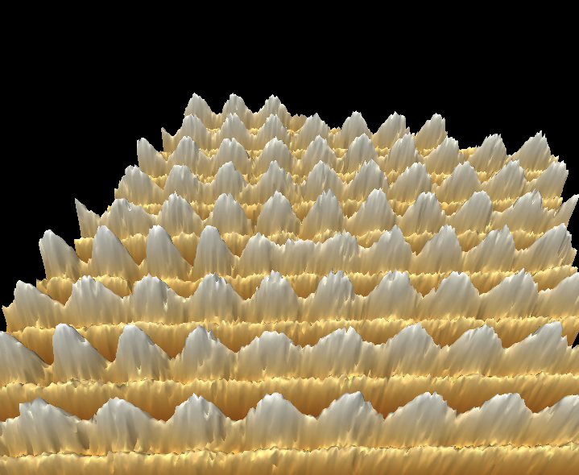
STM view of the CDW1 in NbSe3
STM is tuned to see only the CDW
The chain
bearing
the soliton
S. B., C. Brun, Z.-Z. Wang, and P. Monceau, Phys Rev Let (2012)

Slide 51
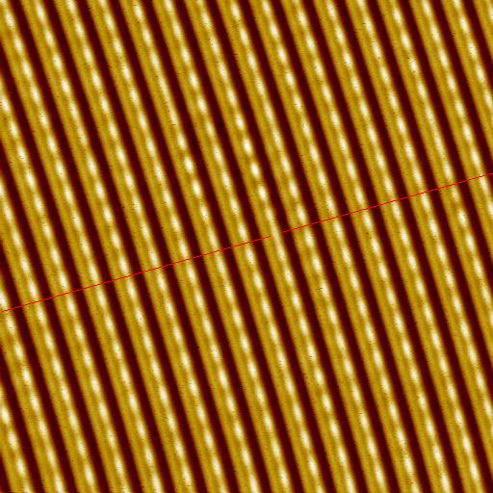
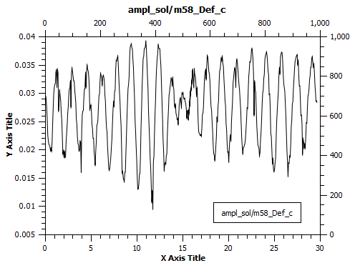
Another presentation of same scan
At the (red) front line, the defected chain
is displaced by half of the period.
Along this chain, the whole period 2π
is missed (or may be gained).
A particle with the charge 2e ? No,
1e - might be created by one electron.
Go to the raw data:
Soliton profile along the defected chain.
The CDW adopts itself by half a period shift and its amplitude vanishes,
presumably to accommodate electron or hole to the mid-gap state.

Slide 52

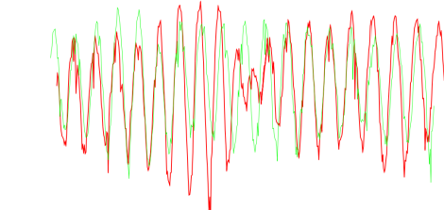
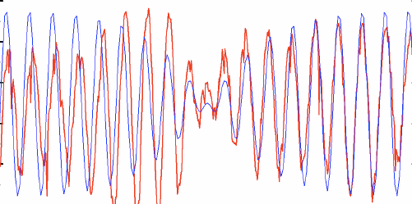
The CDW is perforated here and there by nodes of amplitude
Profile along the defected chain
vs its nearest neighbor
Defected chain vs theory
Phase stretching by π over long tails allows the amplitude kink to adapt to a long range 3D order. General concept: topologically
bound complex of the kink core and the half-integer vortex.

Slide 53
Soliton is a light particle, M_{s}~m_{b}.
To be seen by STM, it needs to be
Immobilized - trapped by a host lattice defect.
Could it be that we saw an impurity effect rather than the soliton?
No, the impurity gives an opposite effect – the Friedel oscillation
which was identifed also in the same set of experiments.
FO~Cos(2K_{F}x)|x|⁻¹ Exp(-|x|/ξ) cf. Ishioka et al, 2011
Low T
High T
High T

Slide 54
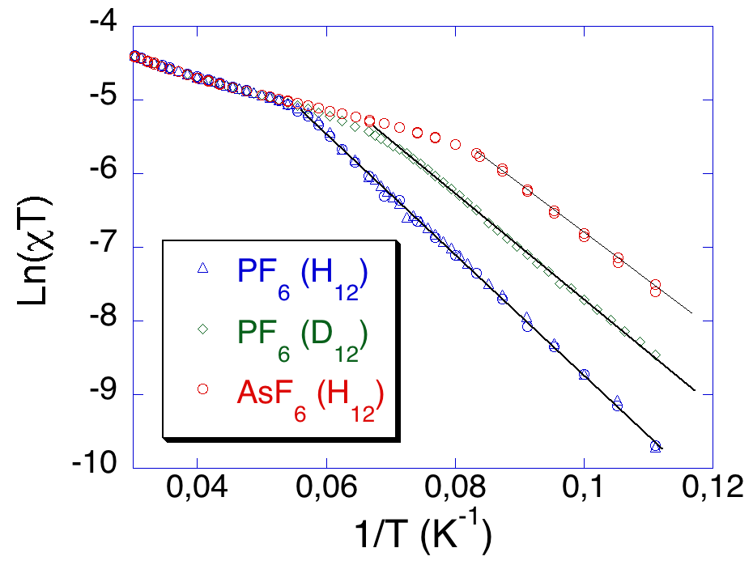
Organic conductors: low scales of gaps allow for their determination
from thermal activation and comparison with optical features.
What does conduct in these “narrow gap semiconductors” ? NOT the electrons, even in the polaronic version !
PF6
AsF6
SbF6
Conductance , normalized to RT
- Ahrenius plot LogG(1/T).
Gaps Δ_{c} for thermal activation of
conductance within 500-2000K.
χ∼exp(-Δ_{s} /T) , Δ_{s} ∼75Κ
Contrarily to normal semiconductors –
NO GAP, or a very small gap Δ_{s},
in spin susceptibility χ(T).
Clearlest example for conduction by
charged spinless solitons - holons.

Slide 55
Collective description for the 1D Mott state on the dimerized lattice.
Spin degrees of freedom are gapless, split-off and not important for a while.
Charge degrees of freedom: phase ϕ=ϕ(x,t)
2K_{F} CDW/SDW ~cos (ϕ+ πx/2a) 4K_{F} CDW~ cos (2ϕ+ πx/a)
Two fold commensurability: pinning potential potential and its degeneracy.
Wave function Ψ distriburtion at E_{F} (for the site dimerisation):
+ o - o + o - o

ϕ=0,π: Ψ=±1 at good sites  and Ψ=0 at bad sites 
ϕ=π/2: Ψ=0 at good sites  and Ψ= =±1 at bad sites 
-
+
-
+
H~ (/4πγ) [v_{ρ} (∂_{x}ϕ )² + (∂_{t}ϕ )2 /v_{ρ} ] - Ucos (2ϕ) + Wcos (4ϕ)
without interactions γ=1 and v_{ρ}=v_{F}
The energy H_{U}= -Ucos (2ϕ) is doubly degenerate between ϕ= 0 and ϕ= π.
It allows for phase π solitons = holons with charge e = CO vacancy defects.
φ=0
φ =π

Slide 56
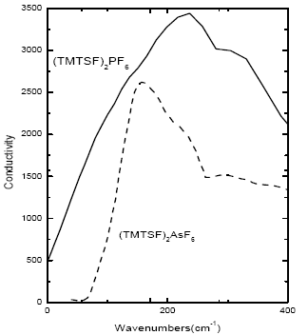
First evidence for solitons = holons:
the activated conductivity with gapless spin susceptibility
Second evidence – optical gaps, even in case of remnant metals.
E_{g}=2Δ - unbound
pair of kinks
Exciton = two-kinks bound state
Peierls
spin gap
Drude
peaks
Optical conductivity (absorption): M. Dressel, L. Degiorgi et al

Slide 57
Effects of subsequent symmetry lifting.
Topologically confined solitons. Spin-Charge reconfinement.
Another present from the Nature:
second symmetry lowing transition of tetramerization
SCN
Ahrenius plots for the cobductivity.
Inclination gives the activation energy
for charge carriers
ReO4
Spin-charge reconfinement below T_{AO} of tetramerisation. Enhanced gap Δ comes from topologically coupled π- solitons in both sectors of the charge and the spin. The last is weakly localized. What does it mean ?
Spin degrees of freedom enter the game:
θ - spin chiral phase, θ′/ π = smooth spin density

Slide 58
Schematic illustrations for effects of the tetramerization
nonequivalence of bonds = , -- between good sites 
endorses ordering of spin singlets.
Also it prohibits translations by one    distance
which were explored by the δϕ=π soliton.
But its combination with the defected unpaired spin
(δθ=π soliton which shifts the sequence of singlets)
is still allowed as the selfmapping –
connction of equivalent ground states

Slide 59
Further symmetry lifting of lattice tetramerization or of spin-Peierls order
mixes charge and spin: additional energy
Vcos (ϕ-β)cos θ - on top of ~Ucos (2ϕ-2α)
ϕ and θ -- chiral phases counting the charge and the spin
ϕ ′/ π and θ′/ π = smooth charge and spin densities
cos θ sign instructs the CDW to make spin singlets over sorter bonds
Major effects of the small V - term :
Opens spin gap 2Δ_{σ} :
triplet pair of δθ=π solitons at ϕ=cnst
Prohibits δϕ =π solitons –
now bound in pairs by spin strings
Allows for combined spin-charge
topologically bound solitons:
{δϕ =π , δθ=π} – leaves the V term invariant
Quantum numbers of the compound particle --
charge e , spin ½ but differently localized:
charge e , δϕ =π sharply within ħv_{F}/Δ_{ρ}
spin ½ , δθ =π loosely within ħv_{F}/Δ_{σ}
s
p
I
n
c
h
a
r
g
e
s
p
I
n

Slide 60
Can the solitons cross the boarder to the higher D world ?
Are they allowed to bring their anomalies like
spin-charge separation or mid-gap states?
Password : confinement.
As topological objects connecting degenerate vacuums,
solitons acquire an infinite energy unless they
reduce or compensate their topological charges.
Various scenarios :
Compensation by the gapless mode S.B. 1980, 2000's
Aggregation into domain walls versus their melting by thermal deconfinement or long rage Coulomb forces
S.B. & T.Bohr 1983, S. Teber 2001
Coupling to structural defects in polymers.
Binding to kink-antikink pairs, origin of bipolarons.
S.B. & N.Kirova, 1981- 90’s
Topological binding to gapless degrees of freedom

Slide 61
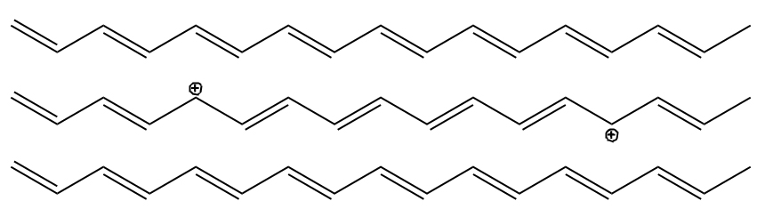
(CH)x – 3D phase
In-phase
Out of phase
In-phase
Interaction of chains brings confinement of solitons into pairs.
In-between the kinks, the interchain correlation is broken,
hence the confinement energy W_{cnf} = F|x|;
The confinement force F>0 is additive to the electric field E, hence erasable : W_{cnf} + W_{E} = F|x|-Ex,F → G=F-E
Notes:
Mismatch between the phase

Slide 62

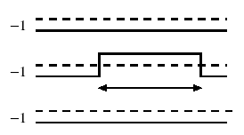
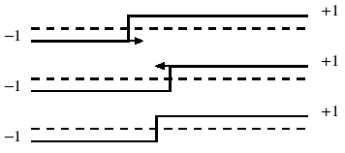


FINITE TEMPERATURE, ENSEMBLES OF SOLITONS,
PHASE TRANSITIONS OF CONFINEMENT AND AGGREGATION.
DISCRETE SYMMETRY only.
Fatal effect upon kinks: global lifting of degeneracy, hence confinement.
Nontrivial but still spectacular:
local lifting in the state with long range order.
Interchain coupling of the order parameter.
Two competing effects:
Binding of kinks into pairs at T<T_{c};
Aggregation into macroscopic domain walls at T<T₀<T_{c}.
Solution for a statistical model T.Bohr and S.B. 1983, S.Teber et al 2000’s

Slide 63




High temperature T > T1: Solitons exist as individual entities.
They already experience long range attractions towards binding them into pair at the same chain (left panel)
or to walls at neighboring chains (right panel).
Intermediate temperatures T1 >T > T2. No more individual solitons, but a gas of their conned pairs. Pairs’ lengths are loose and fluctuate at T1 > T > J; they are tight at J > T > T2.

Slide 64
Lower temperature below T2:
Another transition (D=3) or a crossover (D=2) for formation of
macroscopic domain walls made from
transversely aggregated kinks.
At T<T2 they are embedded to the gas of bikinks;
At T→0 they absorb all particles.

Slide 65


T=2.1J⊥
T=2.0J⊥

Slide 66
Major puzzle and inspiration in CDWs: amplitude solitons
within the long range ordered phase at T<T_{c}
Obstacle : confinement.
Changing the minima on one chain would lead to
a loss of interchain ordering energy ~ total length.
Need to activate other modes to cure the defect !
Unifying observation :
combination of a discrete and continuous symmetries
Complex Order Parameter O= A exp[iϕ] ; A - amplitude , ϕ - phase
Ground State with an odd number of particles:
In 1D - Amplitude Soliton O(x=-∞) ⇔ - O(x=∞)
performed via A ⇔-A at arbitrary ϕ=cnst
Favorable in energy in comparison with an electron, but: Prohibited to be created dynamically even in 1D
Prohibited to exist even stationary at D>1
RESOLUTION – Combined Symmetry :
A ⇔-A combined with ϕ→φ+π – semi-vortex of phase rotation compensates for the amplitude sign change

Slide 67

core : kink –
spin carrier
flux lines
of ½ -vortices
kink – roton combination, exemple of the superconductor or the CDW.

Slide 68
SPIN-GAP cases - superconductivity or incommensurate CDW.
Bosonisation language :
Η_{1D}~(∂θ)² -Vcos(2θ)} +(∂ϕ)²
V - from the backward exchange scattering of electrons
In 1D : Spinon as a soliton θ→ θ+π hence s=1/2
+ Gapless charge sound in ϕ.
CDW order parameter ~ ψ†_{+↑} ψ_{-↑} + ψ †_{+↓} ψ_{-↓} ~ exp [iϕ] cosθ
Its amplitude cosθ changes the sign along the allowed π soliton
Same for the superconductivity with another (gauge) phase ϕ
At higher D : allowed mixed configuration
θ → θ+π , s=1/2 ϕ → ϕ+π , e=1
↑spin soliton ↑ ↑charged wings↑
Spinon as a soliton +
semi-integer π-vortex of ϕ
confined
spin

Slide 69
At presence of unpaired spins, the vortex created by rotation (magnetic field) splits into two semi-vortices.
Spatial Line Nodes and Fractional Vortex Pairs in the FFLO Vortex State of Superconductors
D. F. Agterberg, Z. Zheng, and S. Mukherjee 2008
Vortex molecules in coherently coupled two-component Bose-Einstein condensates
K. Kasamatsu, M.Tsubota, and M. Ueda 2004
Last step: reformulate these results inversely –
unpaired spin creates the vortex pair
at NO rotation/MF.

Slide 70

Propagating hole as an amplitude soliton.
Its motion permutes AFM sublattices ↑,↓
creating a string of the reversed order parameter:
staggered magnetization. It blocks the direct propagation.
Bulaevskii, Khomskii, Nagaev.
Brinkman and Rice.
Adding the semi-vorticity to the string end heals the permutation
thus allowing for propagation of the combined particle.
spin flipping
spin rotations
by hole motion
Alternative view:
Nucleus of the stripe phase or the minimal element of its melt.

Slide 71
Half filled band with repulsion.
SDW rout to the doped Mott-Hubbard insulator.
Η_{1D}~(∂ϕ)² -Ucos(2ϕ)+(∂θ)²
U - Umklapp amplitude
(Dzyaloshinskii & Larkin ; Luther & Emery).
ϕ - chiral phase of charge displacements
θ - chiral phase of spin rotations.
Degeneracy of the ground state:
ϕ →ϕ+π = translation by one site
Staggered magnetization ≡ AFM=SDW order parameter:
O_{SDW} ~ cos(ϕ) exp{±i(Qx+θ)} , amplitude A= cos(ϕ) changes the sign
To survive in D>1 : The π soliton in ϕ : cos ϕ → - cos ϕ
enforces a π rotation in θ to preserve O_{SDW}
spin flipping
spin rotations
by hole motion

Slide 72
OUTLOOK
Existence of electronic solitons is proved experimentally for CDWs in several classes of quasi-1D conductors.
Solitons feature self-traping of electrons into mid-gap states and separation of spin and charge into either spinons or holons, sometimes with their reconfinement.
Continuously broken symmetries allow for solitons to enter
D>1 world of long range ordered states: SC, ICDW, SDW.
Solitons take forms of amplitude kinks, topologically bound to
semi-vortices of gapless modes – half integer rotons.
These combined particles substitute for electrons: certainly in quasi-1D systems – for both charge- and spin- gaped cases.
The description is extrapolatable to strongly correlated isotropic cases: from dopped AFM insulators to FFLO in superconductors.
Here it meets the picture of fragmented stripe phases.

Slide 73
Cyclobutane C₄H₄
4 carbon atoms – 4 π-electrons
Instability
square --> rectangle
Jahn-Teller --> Peierls
Wave functions:
Ψ₁=cos 0•n=cnst
Ψ₂=cos(πn/2)
Ψ₃=sin(πn/2)
Ψ₄=cos πn=(-1)^{n}
Half filled doubly degenerate level 2,3
gain electronic energy -2Δ
loose deformation energy

Slide 74
Isolated benzene ring
H H
C C
H C C H
Degenerate level is completely filled –
no gain from reducing the hexagon symmetry.
We only loose the deformation energy
C C
H H
N=8 – again the instability, like for N=4: what’s next, and at large N ?

Slide 75
Long chain – polyacethylene : N→∞, no distinction for particular N.
Which scenario will win?
Answer:
Jahn-Teller instability evolves into much smaller but universal Peierls effect
N=L/a
k_{n}→2πn/L continuum at L→∞
E_{p} →E(p)=-2t coska
Molecular distortion → chain dimerization
t₁
t₂
t₁
t₂
t₁
t₂
t₁>t₂ a₁<a₂
a₁
a₂
a₁
a₂
a₁
a₂
Dimerization – doubling period , a→2a
Wave number Q=π/a –
just to hybridize states at ±k_{F}=±π/2a
It hybridizes also the states at k≠ k_{F} but
with the energy mismatch v_{F}δk_{F}
- k_{F}
k_{F}

Slide 76
Dream
Reality
H
H
H
C
C
C
C
C
H
H
Peierls effect - one dimentional chain of equidistant atoms is
unstable with respect to the dimerisation: it results in the dielectric state, the gap is opened in the electronic spectrum.
E
E
Δ∝Wexp(-1/λ)
ε_{F}
-k_{F}
k_{F}
-k_{F}
k_{F}

Slide 77
Peierls model - deformable lattice
Main interactions : electron – phonon coupling
(electron-electron repulsions are small)
Diabatic energy: W=W_{el}+W_{lat}

Slide 78
Peierls model - deformable lattice
Main interactions : electron – phonon coupling (electron-electron repulsions are small)
Ground state energy (per unit length): W = W_{el} + W_{lat}
W
-Δ₀
Δ₀
symmetry Δ→-Δ
Δ

Slide 79



Calculated GS energies
as functions of the
gap value
at different T.

Slide 80

Short-range on-chain correlations versus 3D long-range order
Modulation of the electronic density and of the atomic positions
Real space
a
Reciprocal space
2π/2k_{F}
a*
-2k_{F}
-2kF
2k_{F} satellite lines
h2π/a
+2kF
+ 2k_{F}
Fourier transform of a modulated chain: diffuse sheets in reciprocal space
detected by diffraction methods (X-ray diffuse scattering techniques)

Slide 81





Slide 82



CDW vibrational mode.
Critical softenning behavior
- Kohn anomaly
Inelastic neutron scattering

Slide 83
Q. Shall we preserve the metallic state if the lattice is not deformable?
A. Not at all, even at weak interactions, if the nesting conditions are still there.
Electrons with a weak repulsion can form the spin density wave - SDW self-consistently, modulating their charge or spin density.
CDW: Q=2k_{F} mixes –k_{F}↑ and k_{F}↑ ; –k_{F}↓ and k_{F}↓
SDW: Q=2k_{F} mixes –k_{F}↑ and k_{F}↓ ; –k_{F}↓ and k_{F}↑
SDW is the case of many organic metals and the special case of cromium
Both CDW and SDW are electronic crystals with 2 electrons per unit cell.
At first sight, they are insulators by general principles of band theory,
even if the bands are formed by a spontaneous symmetry breaking.
But this degeneracy brings to life new ingredients:
collective modes and solitons.

