Slide 1
SWITCHING OF CORRELATED ELECTRONIC STATES
BY OPTICAL OR VOLTAGE PULSES
IN APPLICATION TO 1T-TaS₂.
Serguei Brazovskii
CNRS- LPTMS, Univeristy Paris-sud, Orsay, France

Slide 2
Serguei Brazovskii
LPTMS, CNRS & U. Paris-Sud, Orsay, France
Planning: intertwined topics.
Most studied quasi-2D systems with CDWs:
layered MX2 compounds, the richest case of 1T-TaS2.
2. Switching of cooperative electronic states by optical and
voltage pulses. Hidden phases.
3. Attempts on a phenomenological theory.
4. Induced networks of domain walls viewed by the STM.
Relevant examples of visualizing the solitons.

Slide 3
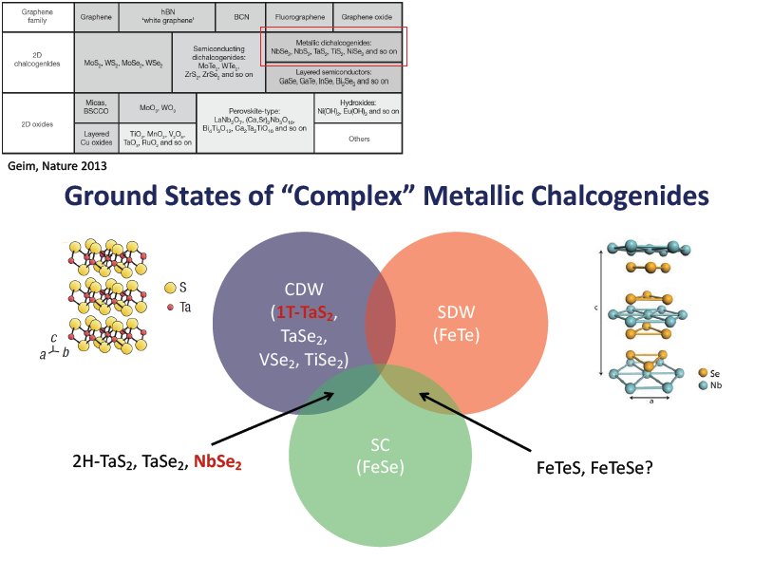
The slide from A. Tsui @ IMPACT-2016

Slide 4
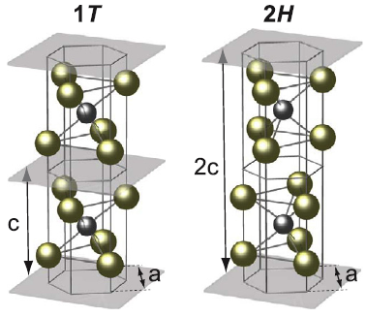
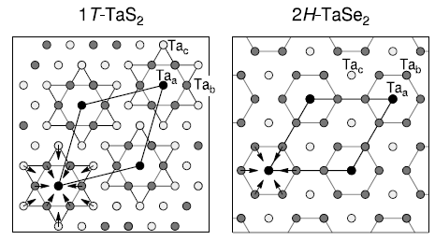
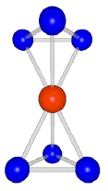
1T-TiSe2 : 2nd order transition at 202 K to a commensurate C state 2 × 2 × 2
2H-TaSe2 : 2nd order transition at 122 K to an incommensurate IC phase close to a 3 × 3 reconstruction,
1st order lock-in transition at 90 K to the 3 × 3 C state.
1T-TaS2 : IC: incommensurate CDW between 543 and 352 K,
nearly commensurate NC state at 352 - 183 K (221 - 355 K upon heating),
C-state below 183 K – with √13 ×√13 periodicity
Versatility reason (?): adaptation of 5d orbitals (z², xy, x²-y²) with
strong spin-orbit interactions to changing environment of S,Se cages

Slide 5
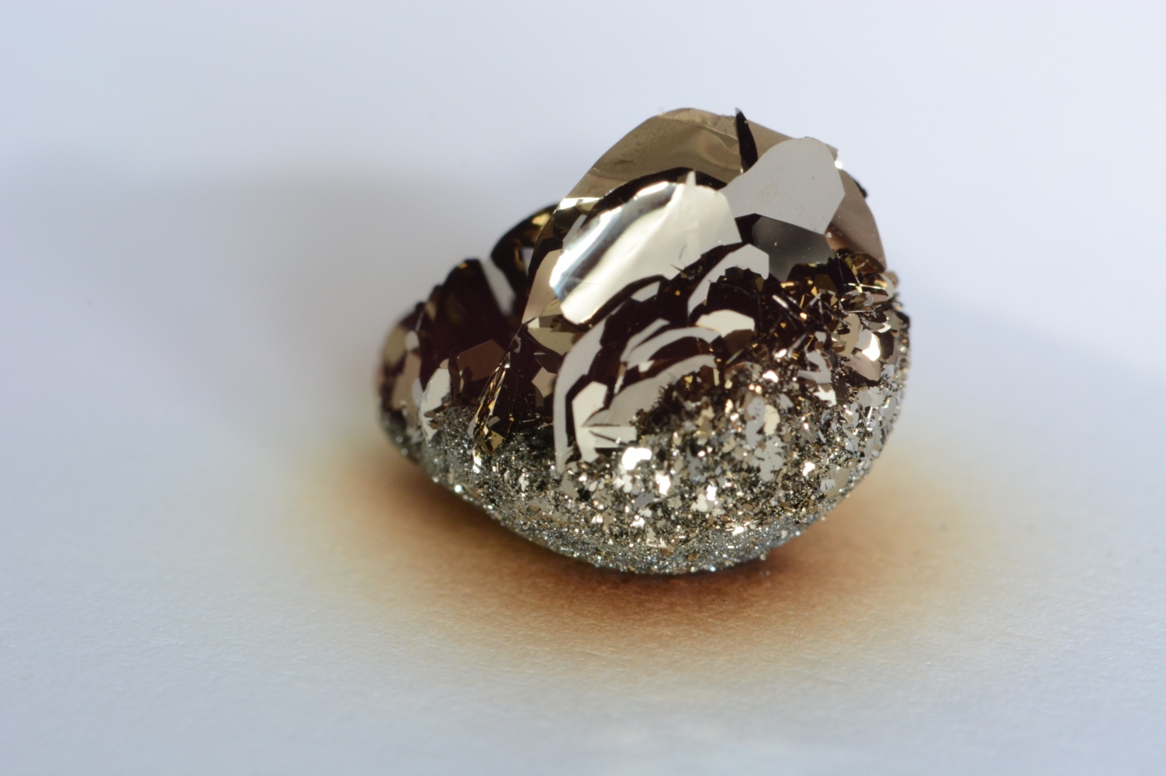
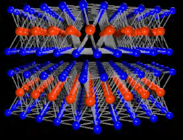
1T-TaS2 - 40 years old mystery and the recent progress.
A system with simultaneous effects of:
1D-2D-3D coexisting regimes,
charge density wave CDW,
polaronic lattice, Wigner crystal, Mott insulator,
multiple thermodynamic and hidden phases,
states switching by optical and electric pulses
1 cm
Crystals of 1T-TaS2

Slide 6
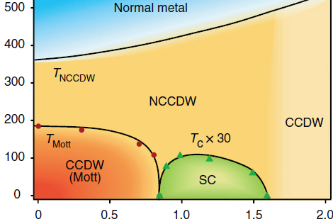
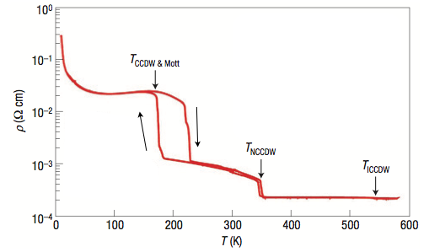
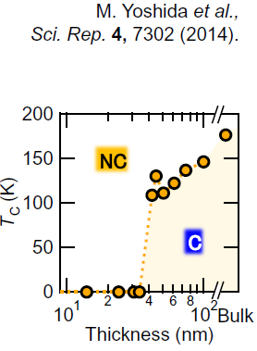
ICDW
TaS_{2-x}Se_{x}
A similar phase diagram for
Fe doping (both from China) and for the pristine 1T-TaS2 under pressure EPFL, Swiss
Another direction of monitoring:
film thickness (Iwasa group)

Slide 7
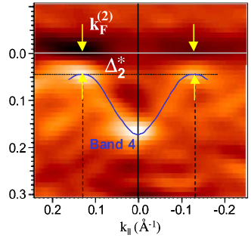
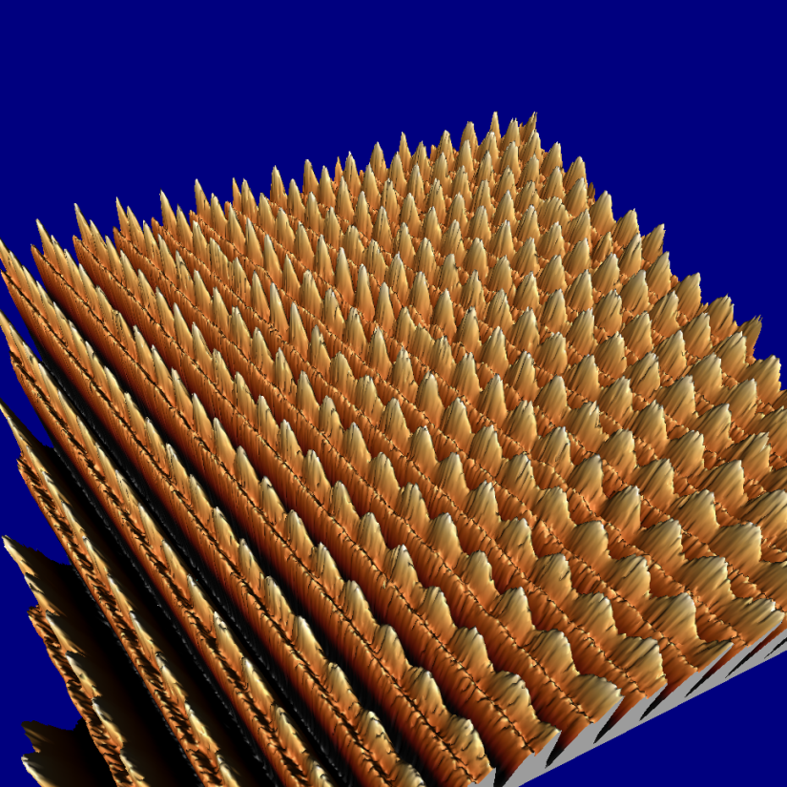
Incommensurate ordered Charge Density Waves – CDW (in NbSe3)
ARPES gives electrons’ spectral density, hence E(k) with the gap Δ
formed by the CDW
CDW
wave
fronts
Scanning Tunneling
Microscopy STM shows
the CDW modulation in
atomic displacements
and the electronic density.
Brun, Wang, Monceau, SB
chains

Slide 8
Conventional CDW versus Wigner crystal
2 electrons per period
1 electron per period
2k_{F} CDW
2π/4k_{F}
4k_{F} CDW =
Wigner Xl

Slide 9
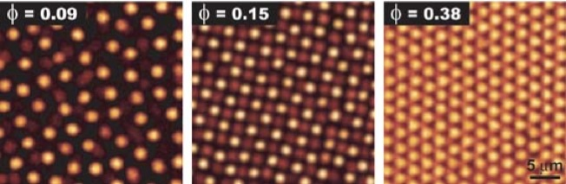

Wigner crystal state in a charged colloidal dispersion.
Microscopic realizations:
Electrons trapped near the liquid He surface
Charge ordering in organic crystals
Superstructure of polarons in TaS2

Slide 10
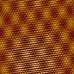
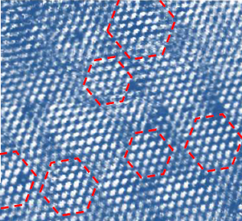
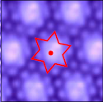
In-plane structure of 1T-TaS2
From diffraction: Tanda, Yamomoto, Ishigura & Sato, van Smaalen
From STM: since Zettle in Berkeley, till the recent avalanche
From theory: Nikanishi & Shiba
Incommensurate
CDW
Nearly commensurate
CDW
Commensurate CDW
STM image
300 K
Notes:
many competing states
trigonal state
Domain walls

Slide 11
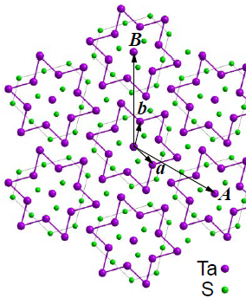
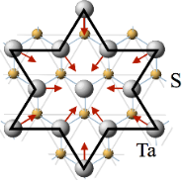




C & NC: Every 13’th Ta atom sits in the “David star” centre
formed by inward displacements of NN and NNN.
It brings here one unpaired electron →
Mott physics on the √13 ×√13 superlattice
b*
$$q_{0}^{C}$$
$$q_{0}^{NC}$$
a*
$$φ_{C}∼13.9°$$
$$φ_{NC}=11.6°∼13.1°$$
This is the Mott insulator because adding another electron will require for the Hubbard repulsion energy U which is of the order E_{g} (Small U but with small W !)
The hexagonal arrangement is frustrating for spins thus preventing their AFM or other ordering which makes it an ideal stage for the “Mottness”
(1976, Tosatti and Fazekas – as also “Andersonness”).
Tosatti, E. & Fazekas, P. On the nature of the low-temperature phase of 1T-TaS2. (1976).

Slide 12
The paradox of the TaS2: a good 1D physics in the inter-layers direction of the apparently 2D system ?
Γ-A in K-space corresponds to the
inter-plane direction.
The strong dispersion comes from the overlap of z² orbitals of Ta,
hence require for their in-line stacking. Is it true?
Only the recent attention - calculations of spectra for different 3D arrangements: Darancet, et al, PRB (2014); Ritschel, et al. Nat Phys (2015).
Need the 3D atomic refinement: Ishiguro 1991, Van Smaalen 2007.
Verdict: Indeed the columns of 13th Ta atoms
but only in the NC phase and only for some of them;
Unit cell contains three cells in the interplane direction.

Slide 13
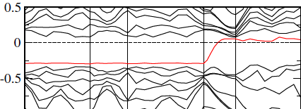
C phase: poorly ordered helicoidal structure
of doublons of planes:
Splitting to bonding-antibonding orbitals:
Two levels instead of the 1D band.
Combination of the Mott and the hybridisation gaps
0
8
0
7
11
0
Later revision: U~1eV at all Ta →
U*=0.18eV at 13’th sites,
t=0.2 is preserved.
Optical gap for transverse polarization Eg=0.25 Triplet excitation: 0.08 eV
Recall:
no threshold for Mott gap in 1D

Slide 14
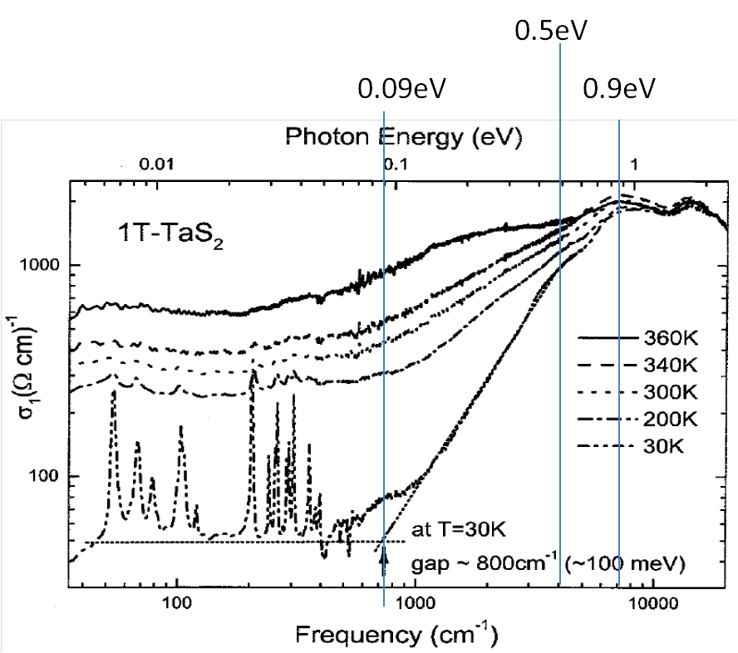
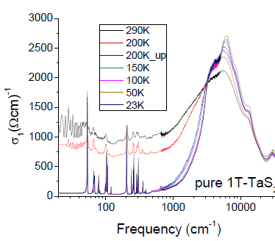
High gaps 0.8-0.9 eV have been inferred from optical (Forro at EPFL),
ARPES (Wolf-Perfetti in Berlin) experiments, and band calculations
K. Velebit 2012
Gasparov et al., (2002).

Slide 15
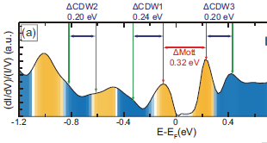
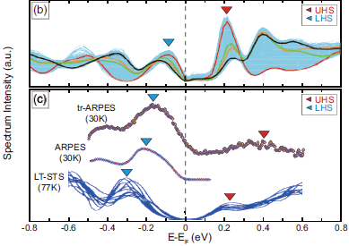
STS spectra in average
and taken at different
tip positions of the
regular C-phase lattice
Resolution of the whole intra-gap spectrum by STM+STS (H.W. Yeom):
CDW and the Mott gap as 0.20-0.24 eV and 0.32 eV
Empty states are resolved – impossible in PES, ARPES.
No momentum resolution →
gaps may be indirect, not accessible in optics

Slide 16
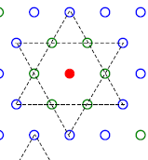
1T-TaS2 – polaronic Wigner crystal view (ours, disputable).
Background: narrow-gap (E_{g} =Δ_{e}+Δ_{h}≈0.6-0.8 eV) insulator formed from parent metal (with 1e per Ta site) by a high-T (>500K) CDW.
Incomplete nesting leaves each 13-th electron ungaped which
in a typical CDWs would give rise to a pocket of carriers.
Here, each excess carrier is self-trapped by inwards displacements of the surrounding atomic hexagon (forming the “David star” unit)
which gives rise to the intragap local level accommodating this electron.
These charged heavy polarons inevitably arrange into the Wigner crystal
which is always a hexagonal super-lattice –
by Nature chance upon the underlying hexagonal lattice
This ideal locked form is the C phase.

Slide 17
Exciting the self-trapped electron from the intragap level
deprives the deformations from reasons of existence,
the David star levels out in favor of a void in the WC while the electron is sent to a higher delocalized band or recombines with a band hole.
Adding an electron to the UHB may lead to a stable bipolaron,
but the energy cost most probably will not allow for its stability.
Mitosis into two polarons will proceed thus creating an interstitial in the WC – both voids and interstitials have been seen by STM.

Slide 18
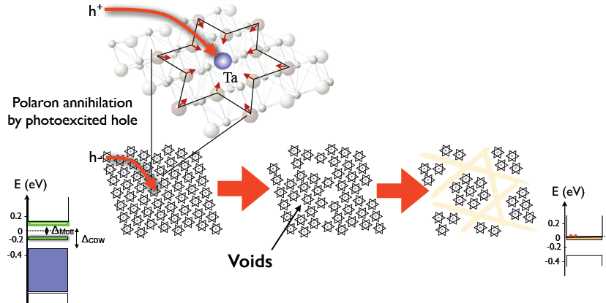
Photo-doping and ordering of voids
Addition of h+ to the C structure annihilates a polaron,
creating a defect –the void. At a sufficient concentration, voids aggregate into walls leaving perfect micro-crystals in-between.

Slide 19
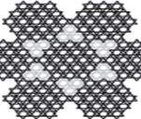

Phase separation: voids are expelled
in-between dense clusters yielding
the near-commensurate NC phase.
If not expelled, then the WC melting
gives rise to the IC phase seen at higher T.
That depends on the curvature sign
of the free energy d²F/dn²=dμ/dn
Such a self-tuned Wigner-Mott state stays
always, even under doping, in half-filled Mott insulator regime:
number of sites is regulated to adjust to the number of electrons.
(common notion in CDWs where #periods=2#electrons).
There cannot be such a thing here as the dopped MI;
this is a WC with (expelled) defects.

Slide 20
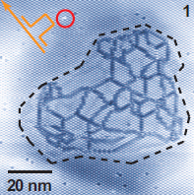
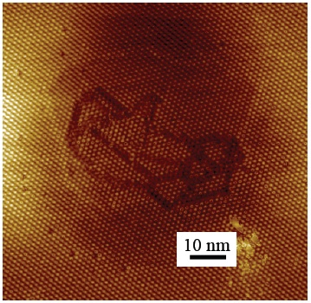
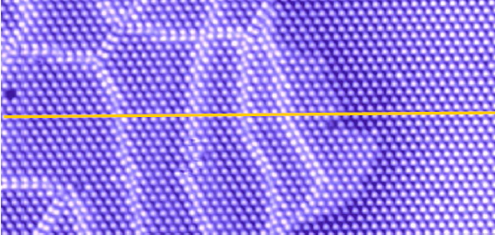
Generation of domain walls’ network by application of the STM pulse
H.W. Yeom group
D. Mihailovic group
China, Y. Zhao, @Fudan+

Slide 21
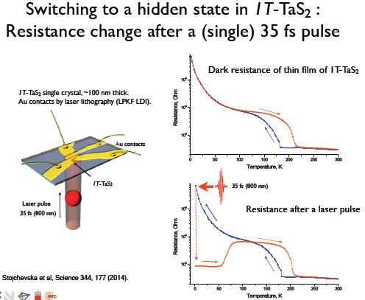
Write: single pulse.
Erase: 10⁴ pulses
Taken from a presentation by D. Mihailovic

Slide 22
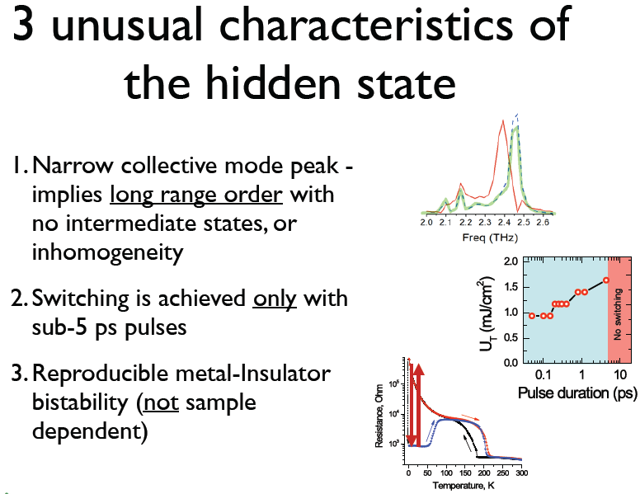
Taken from a presentation by D. Mihailovic

Slide 23
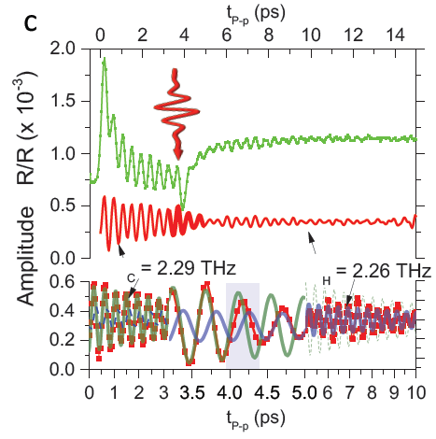
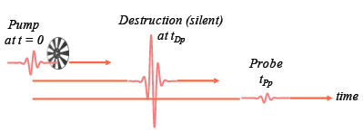
Three-pulses experiment:
excitation of the amplitude mode AM, destruction, probe.
(recall coherent phase control by S. Koshihara)
AM frequency changes smoothly from 2.29 to 2.26 THz
within ≲ 500 fs, which is close to one AM period ( 440 fs)

Slide 24
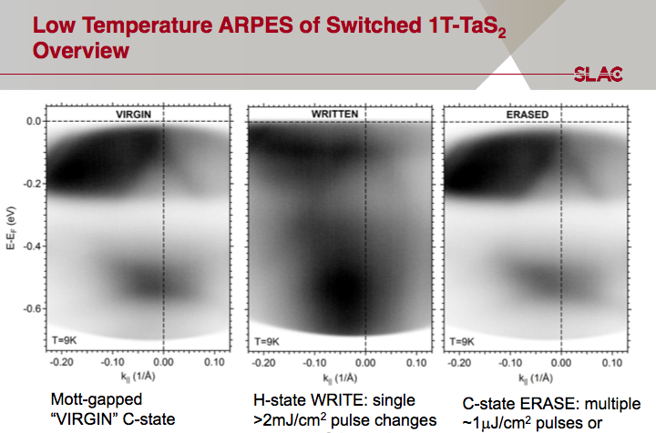

50 fs
Notes:
What’s happening to the electronic structure?

Slide 25
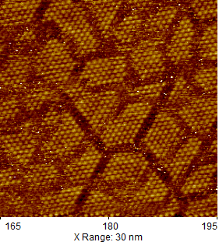
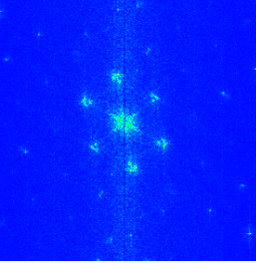
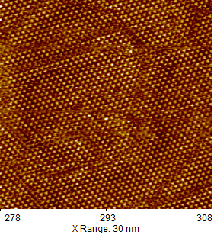
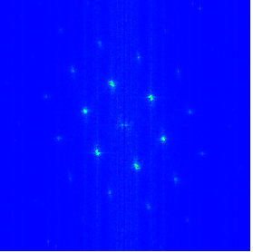
Domains’ network after optical and STM switching
D. Mihailovic group
FFT
5 nm
5 nm
Optically switched
Switched by STM tip
Networks of walls appear both optical pumping and the local pulse
from the STM tip - both measured by the same STM.
Walls are lines of missed David stars – hence, and proved, insulating.
Their number determines the concentration of defects
– aggregated voids – working as dopants for domains.
Their concentration yields the electron-hole imbalance.

Slide 26
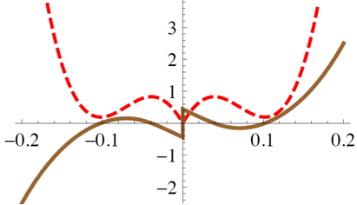
Modeling of the optical route to the hidden phase in TaS2.
Phenomenology starts as a guess for the free energy as a
function of defects concentration F_{d}(n_{d}).
That could be any double-well curve for the energy to give rise
to a 1st order C-IC transition – the experimental fact.
We narrow the choice applying the qualitative theory for incommensurable superlattices by Bak and Villain where
the 1st order is explained as effect of crossings of domain walls.
F_{d}
F_{d} and the chemical potential μ_{d}=dF_{d} /dn_{d} as functions of defects concentration. Notice the cusp – not the generic smooth minimum at n_{d}→0 – initial doping of C phase
μ_{d}

Slide 27
F_{d} (n_{d}) is the basic energy of the NC state with respect to the C one.
C₀<1 drives the NC instability at C₀<0
C1 -- stabilizing DWs repultion
Energy <0 of DW crossings
Repulsion of crossings
C₂
C₄
Here n_{d} is the concentration of voids aggregated into walls.
Otherwise, in the IC phase, n_{d} =n(voids) – n(interstitials).
In any case, the conservation law of electrons:
n_{e}-n_{h} = n_{v}-n_{i}= n_{d}

Slide 28
Quasi-equilibrium states and rates of equilibration are determined by
the game of partial chemical potentials for each reservoir of electrons.
For band states near rims of the band gap – free 2D electrons:
DOS
μ_{e}
Example:
μ_{e}> Δ_{e} – degenerate Fermi gas of electrons
|μ_{h}|< Δ_{h} -- thermal activation, Boltzmann gas of holes
Δ_{e}
-μ_{h}
-Δ_{h}

Slide 29
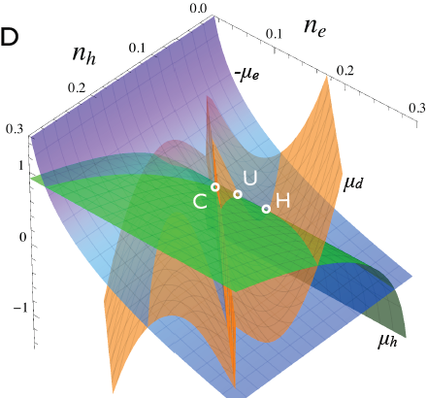
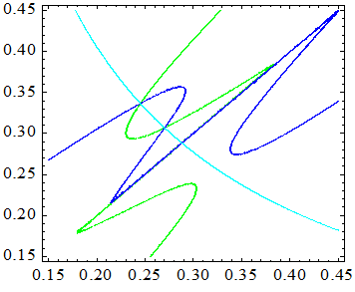
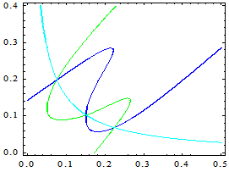
μ_{e}(n_{e})=-μ_{h}(n_{h})
H
U
C
Chemical potential surfaces -μ_{e}(n_{e}) , μ_{h}(n_{h}), μ_{d} (n_{e}-n_{h})
C,U,H are triple intersections where -μ_{e}(n_{e})= μ_{h}(n_{h})=μ_{d} (n_{e}-n_{h}).
C and H are local equilibriums under constraint n_{e}-n_{h} = n_{d}.
In C, n_{e}=n_{h ,} n_{d}=0; points H and U are IC states,
Point U of the energy maximum is repulsive.
Variations of parameters and temperature
can change plot's topology.
No C-phase

Slide 30
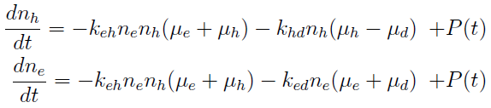
Rates eqs. for concentrations are designed minimalistically -
just to satisfy the requirement that binary rates pass through zero when chemical potentials become equal.
Here k_{ij} are just constants but they may be T-dependent.
μ_{i} = μ_{i} (n_{i},T) are T-dependent for sure, so a need to add an eq. for the evolution of T→T_{e}(t) – the electronic temperature.
T branches to the electronic T_{e} for μ_{e} , μ_{h} and the lattice one for μ_{d}
To cover shorter times, these rates eqs. should be generalized to kinetic eqs.

Slide 31
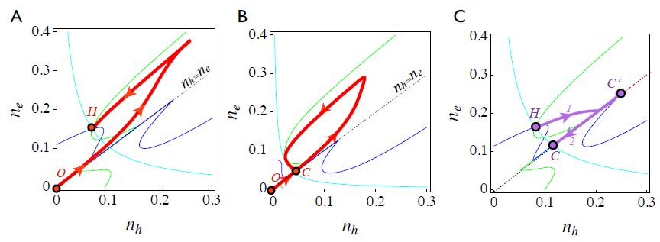
Trajectories - parametric plots of n_{e}(t) and n_{h}(t) superimposed on lines
of partial equilibriums given by intersections μ_{e} =- μ_{d} , μ_{h} = μ_{d} , μ_{e} = -μ_{h}
- drawn for the final temperature after the system has stabilized.
A: Above the switching threshold U>U_{T} - reaching the H-state
B: Below threshold U<U_{T}. The system returns to the C state.
C: Erasure by heating in the H-state .
Trajectory first leaves the H-point, then joins the commensurate line.
After reaching a maximum C', on cooling the system returns to point C.

Slide 32
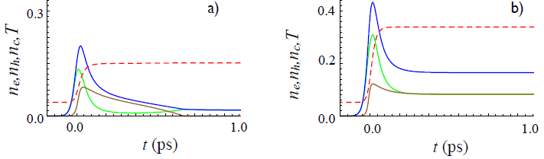
T_{e}
a) Below threshold: n_{e}→n_{h} , n_{d} →0
b) Switching

Slide 33
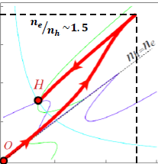
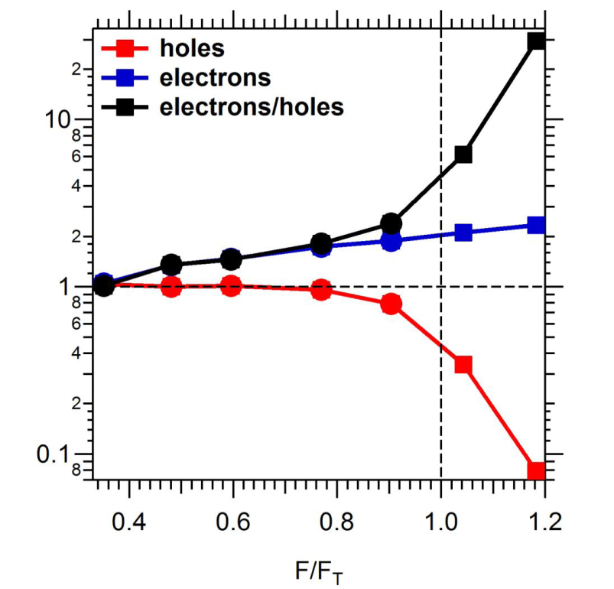
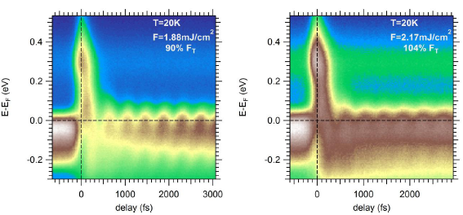
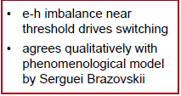
The moment of truth:
tr-ARPES of the H phase,
after Patrick S Kirchmann (Stanford, unpublished)
“trARPES suggest that e-h imbalance
drives switching”

Slide 34
Switching by voltage pulses. Mihailovic and Iwasa groups
Fast non-thermal current-induced switching between
charge ordered many body quantum states in TaS2.
D. Mihailovic group, Nat. Comm. 2016

Slide 35
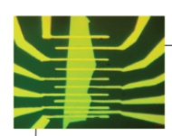
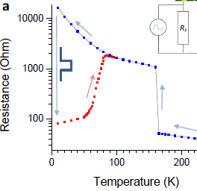


T=14 K, thickness=80 nm,
contacts spacing 8 μm

Slide 36

Write: no dependence on pulse durations down to 40ps: leading edge effect
Read: need pulse > 0.1 sec

Slide 37

Iwasa group. Sci. Adv. 2015
Thin samples →C-phase suppressed, NC phase relaxation prolonged,
Switching first to more insulating and then to metallic states.
Similar in-plane voltages E~V/mkm

Slide 38
Theory attempt:
Instability towards stripe formation in 1T-TaS2 after charge injection.
A generic bistable system in between two contacts.
Commonly, a potential applied to a sample is expected
to concentrate the local charge density at the contacts
so that the applied field is screened.
In our special situation the charge penetrates into a bistable medium in which the competition of phases is controlled by the particle density n.

Slide 39

a: approaching a generic
1st order transition.
Thermodynamic quantities as functions of concentration n for bi-stable systems near the 1st order phase transition:
free energy E (brown),
chemical potential μ (red),
its derivative k (blue-dashed).
b: the 1st order transition
of commensurability .
𝐸(𝑛) at small n has a cusp, it starts
as E∝𝑛 and then slows down.
E(𝑛) is concave around the low n phase:
the compressibility is negative
𝑘 = 𝑑𝜇/𝑑𝑛 < 0 for all n up to the inflection point of E(𝑛)
which lies between the barrier
and the high n minimum.

Slide 40

For a charged system, this violation of the stability criterion means that the screening length square becomes negative
Then 𝑙_{𝑠𝑐𝑟} becomes imaginary. That leads to oscillations
instead of the conventional exponential decay with distance,
resulting in phase separation and stripes formation.
For our nonlinear system, this feature is hidden in eqs. for the density
n(x) and the electric potential Φ(x) which we solve numerically

Slide 41

Undulations between “hole-doped” and “electron-doped” domains,
𝑛 > 0 and 𝑛 < 0.
With increasing j, patterns evolve from a nearly sinusoidal shape to sharp domains whose number decreases progressively, until the last strong one remains near the contact at 𝑥 =1
(𝑥 = 0 is the middle of the sample)
while the bulk is converted to a highly conducting state with smooth and weak undulations.
At low j, the period does not vary much with j and stays close to the intrinsic value ∼ 2𝜋𝑙_{𝑠𝑐𝑟} .
𝑥 = 0, sample’s middle
𝑥 = 1, sample’s edge

Slide 42
Summary for TaS2.
TaS2 as a self-tuned, phase-separated, always filled, Mott state of a Wigner crystal of polarons, swallowing excited holes as vacancies,
then expelling them out to form the net of domain walls.
Mutual transformations among the three reservoirs: electrons, holes, defects are dictated by imbalances of partial chemical potentials.
The e-h compensated just pumped C state evolves into the noncompensated (self-doped) H state.
Walls crossings are responsible for the free energy form yielding the 1st order phase transition and the screening instability: undulating penetration of the electric field into the bulk under the applied current.
Incompleteness of the presented phenomenological approach:
It is over-coarse-grained, averaged over the network of domain walls.
Need to descend to the single-wall, single-node level.
Descriptions of optically- and current-induced routs
to the hidden phase are not well connected yet.

Slide 43
Theories of temporal processes in out-of equilibrium
strongly correlated electronic systems:
1. Ab initio calculations or many-body approximations for microscopic
models: highly challenging difficulties, great efforts, very useful results.
Limitation to small # of particles even in 1D, problem of energy release.
2. Phenomenological approach for regimes governed by collective
variables like order parameters for electrons and lattice deformations.
It becomes indispensible for spacio-inhomogeneous regimes with
patterns formation.
It allows to approach coherent dynamics of macroscopic electronic
order through a symmetry breaking transition, to recover
dynamical symmetry breaking, stratification in domains, etc.
It is always correct within its applicability, but it may not come rightly:
the quasi-equilibrium regimes may be reached only after
the most interesting events had happened.

Slide 44



The CDW is perforated here and there by nodes of amplitude
Profile along the defected chain
vs its nearest neighbor
Defected chain vs theory
Phase stretching by π over long tails allows the amplitude kink to adapt to a long range 3D order. General concept: topologically
bound complex of the kink core and the half-integer vortex.

Slide 45


Observation of a soliton in a truly 1D physics, Han Woong Yeom, Pohang
The array of Indium chains at Si 111 surface.
Ground state: 2-fold commensurate CDW, discrete Z₂ symmetry of dimerization. Realization of the Gross-Neveu model and KdV.
E
E
E_{F}
-k_{F}
k_{F}
-k_{F}
k_{F}

Slide 46


Strong defect immobilizes
the soliton at a below chain
Excellent fitting similar to NbSe3
with ξ= 3.4 nm=9a
Amplified central view
Hopping of solitons’ was noticed – mobile intrinsic defect !

