Slide 1
Excursion #2
We shall meet the chiral anomalies as they appear already in simplest, MF or BCS types, models particularly at finite temperatures when normal excitations are present.
The resulting effective Ginzburg-Landau theory will prove to be quite different from what is commonly expected.
After collaboration with Natasha Kirova in 1999 and 2018-9
Inspired by experimental studies in Grenoble by P. Monceau et al
and at Cornell, R. Thorne group

Slide 2
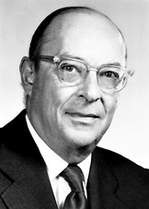
John Bardeen’s Grand Unification:
……
1940’s - transistor
1950’s - Superconductivity
1976 – 30/01/1991- - Charge Density Waves
Common features of incommensurate CDWs and the superconductors:
O_{cdw} =Acos(2K_{F}x+ φ) → complex order parameters O_{cdw,sc} ~ A exp[iϕ]
hence vortices ←→ dislocations, phase slips ←→ phase solitons
Similar microscopic theories: Peierls-Frohlich vs BSC
Pair-breaking gaps 2Δ - hence tunneling, FFLO ←→ solitonic lattices
Tighter links at D=1: Spinons as amplitude solitons
Phases ϕ_{cdw} , ϕ_{sc} are in conjugation: [ϕ_{i}, ∂_{x}ϕ_{j}]~δ(x)
2Δ becomes the common spin gap; broken pair becomes 2 free spinons
The same current is j=- ∂_{t}ϕ_{cdw} /π∼ ∂_{x}ϕ_{sc}
the local density ρ=- ∂_{x}ϕ_{cdw} /π ∼CDW wave number shift δQ=∂_{x}ϕ_{cdw}

Slide 3
Collective motion of electronic crystals:
Incommensurate CDWs, SDWs, Wigner crystals:
Frohlich conduction by the collective sliding.
Topological defects: solitons, dislocations (electronic vortices).
Current conversion among normal and condensed electrons.
Phase slips in nano-junctions.
While the phase velocity or deformation is the principle ingredient,
no collective effects can set in without deformations of the CDW amplitude A(x,t),
particularly with A passing though zero.

Slide 4
Dynamic origin of dislocations
source
v∼I
drain
Direct access to the current conversion via dislocations: Space resolved X-ray studies
v=0
Formation of new planes in the electronic crystal
Elimination of additional planes
proliferation of a dislocation line.
CDW sliding in the applied external electric field – collective motion of electronic crystal .
To set it in motion at different velocities:
Transfers flow of vortices – thick channel
Coherent phase slip - thin cannel
(Maki & Ong, Gorkov)
enhanced v
normal v
ceased curent
the material flow; its conversion provides the climb of dislocations.
Phase slips:
Microscopically – selftrapping of electrons into solitons, their subsequent aggregation
Macroscopically – the edge dislocation line proliferating/expanding across the sample.
Static origin of vortices in analogy to SCs

Slide 5
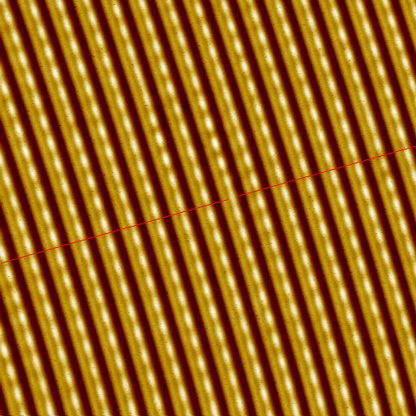
Topological defects in a CDW.
Solid lines: maxima of the charge density.
Dashed lines: chains of the host crystal.
By passing each of these defects, the phase changes by 2π.
Far from the defect the lattice
is not perturbed.
Embracing only one chain of atoms, the pairs become a vacancy or an interstitial ⇒ ± 2π solitons in CDW
At the (red) front line the defected chain is displaced by half of period.
Along the defected chain the whole period ±2π is missed or gained

Slide 6
Ginzburg-Landau – like model
Only extrinsic (other bands) carriers n are taken explicitly.
In the GL spirit, the intrinsic carriers (in the gap region) are integrated out, their effect is hidden in the CDW amplitude A.

Slide 7
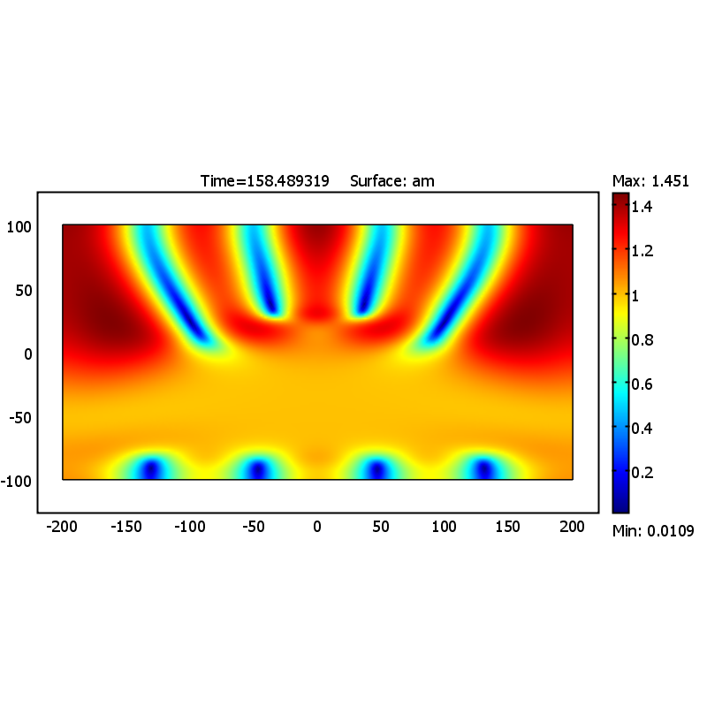
Numerical modeling of nonstationary processes in CDWs
within the TDGL phenomenology
T. Yi, A. Rojo, N. Kirova and SB.
traces of A=0
nucleations
Many vortices appear temporarily in the course of the evolution.
For that run, only one will be left.
The result is as spectacular as it is wrong!
The TDGL approach is principally deficient here.

Slide 8
Deadly problems with the TDGL model for CDW
Well established and works for stationary state and as a tool to reach it. Takes explicitly the extrinsic carriers (not interacting with the CDW)
Restrictions:
The intrinsic carriers have been integrated out and come into the model only via the order parameter amplitude A.
Major problem:
Violation of the local charge conservation for the condensate .
automatically if A = const
In our case A(x,y,t)≠0
Way of resolution: keep carriers in hand and decompose A²

Slide 9
More general scheme :
1D intrinsic carriers are taken explicitly into account
Forbidden : scattering in the frame of the host lattice - no impurities
Allowed: scattering by CDW phonons; electronic collisions
Ψ=(ψ₊,ψ₋ ), order parameter Δe^{iϕ}

Slide 10
Chiral transformation:
Interactions depends only on derivatives of ϕ, i.e: no Umklapp processes , Electrons scatter on each other and on CDW phonons

Slide 11
PROBLEM 1
Action = free energy W after integration over fermions:
can choose
False local “gauge” invariance – the potential can be excluded at no cost
In absence of normal carriers we definitely expect:
- Not a full square of the chiral-invariant combination:
∼Φ² looks to be an anomaly - and not only

Slide 12
PROBLEM 2
By definition :
For conducting electrons
We obtain:
We expected to have:
W_{e}
W_{e}
Tc
T
Tc
T

Slide 13

Resolution: the whole expression has been lost
Chiral anomaly
Now, for linearized eqs. and with constant ρ_{n}=1-ρ_{c}
The contribution of normal carriers bites from the T=0 anomalous action erasing it down to zero at T_{c} when A∼Δ→0, ρ_{c}∼A²
In relativistic field theory language (I. Krive and A. Rozhavsii for CDWs at T=0):
-eEϕ

Slide 14
Nonlinear regime. Local energy functional
Expect A² - actually 1.
Non analytic in Ψ
Both terms are not
derivable perturbatively
– the chiral anomaly.
n_{in}, n_{ex} concentrations of intrinsic and extrinsic free carriers
F(A,n_{in},n_{ex}) static free energy, not additive any more
Its minimum at A≠0 is erased at n_{ex} above a critical value (vortec core)
+ need a mechanism for n_{in} to compensate ∂ϕ at A→0

Slide 15
Possible simplifications and explitness
Infinite conductivity: - a bridge to the naive GL eqs.
Poisson eq.
screening of E_{x} with a
standard local screening
length l²=r₀²/ ρ_{n}
LHS resembles the static effective charge n_{c}=A²∂_{x}ϕ/π - identifying ρ_{c} and A²
But instead: ∂_{x}n_{c}= ρ_{c} ∂_{x}²ϕ /π
Never a closed expression for j
Phase eq.
Resembles GL with ρ_{c} as A² but
with no differentiation of the amplitude :
ρ_{c}∂_{x}Φ instead of ∂_{x}(A²Φ)
ρ_{c} ∂_{x}²ϕ instead of ∂_{x}(A²∂_{x} ϕ)
Not like variational eqs.

Slide 16
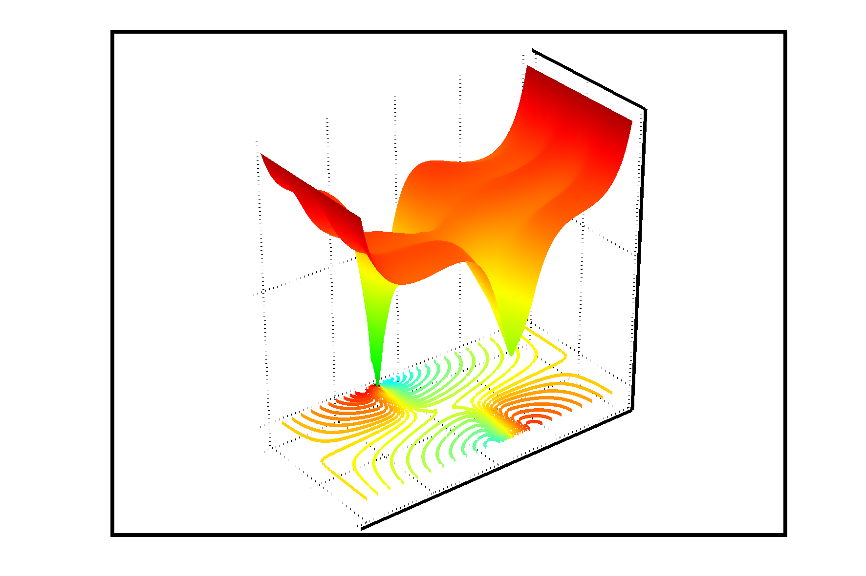
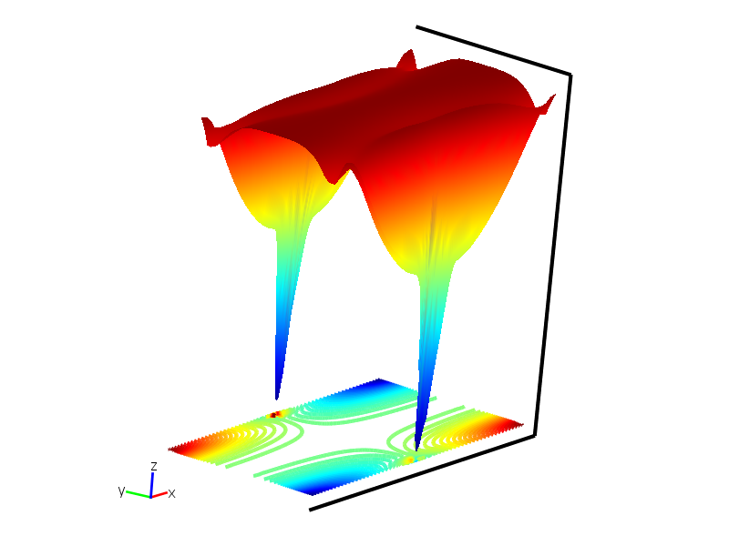
Nonanalytic dependence on the amplitude requires new
more complicated numerical studies.
We still can run up to nucleation of vortices at a surface.
But then the program crashes and
we cannot trace proliferation of vortices as before.
A price for no explicit compensation of diverging ∂ϕ by vanishing A²

Slide 17
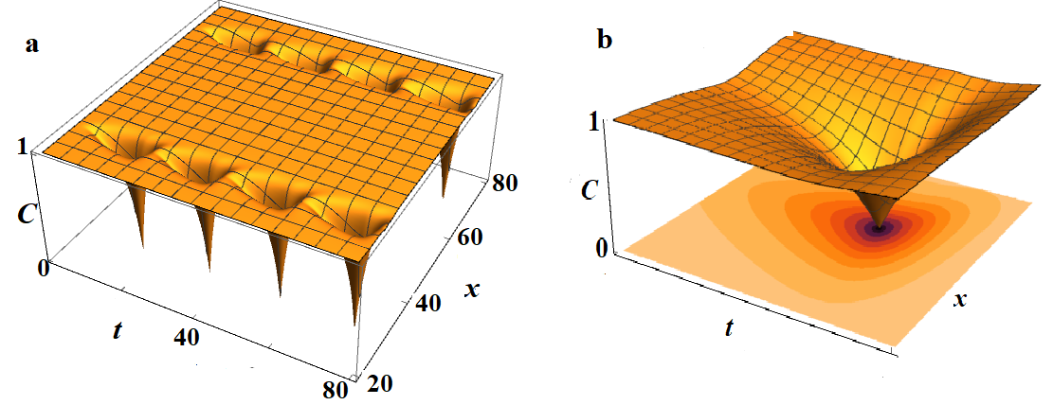
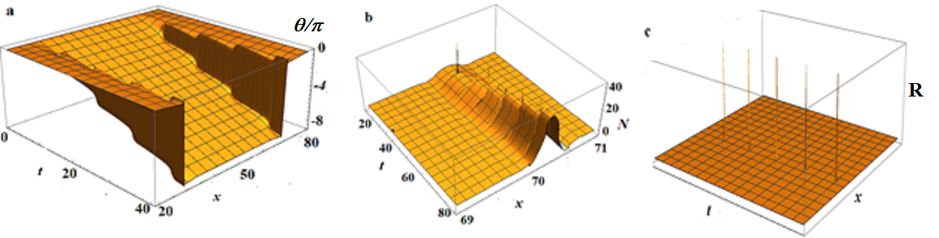
Thanks to substantial simplifications of the free energy form:

Slide 18
Conclusion and perspective.
Chiral transformations with account for chiral anomaly
were applied to the CDW model
Two-fluid hydrodynamics was constructed for the order parameter and the normal liquid
Topologically nontrivial dynamics appears under applied fields or charge injection
Spontaneous space-time vorticity under the driving current was modeled numerically some under simplifications,
periodic sequence of amplitude nodes with 2π phase increments was demonstrated
The numeric procedure needs to be stabilized for the nonanalytic eqs.
The problems of glide and climb should be considered

