Slide 1
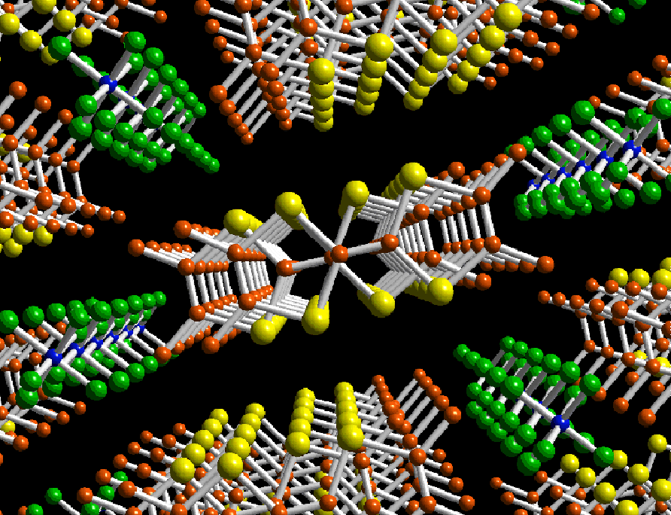
« In the beginning was the Word, …
and without him was not anything made that was made »
Excursion #4.
Glorious time of early 1980s, superconductivity in organic crystals, after a decade of a crazy and ambitious run over the world , the breakthrough here, at the LPS in Orsay, Denis Jerome and colleagues.

Slide 2
Those days the 1D models were studies to understand the phase diagram of quasi-1D systems – the source for today’s excursion.
The intrigue against common beliefs: the 1D T=0 phase diagram based upon diverging power-law susceptibilities, does not want at all to reproduce itself when electrons are allowed for the interchain hopping. The system falls to the Fermi-liquid regime unless the real or curious “imaginary” gaps appear from external symmetry lowering due to the crystal field or the magnetic field.
S. Brazovskii & V. Yakovenko, "On the theory of phase transitions in organic superconductors“ J. de Physique Lett. & JETP (1985), JETP Letters (1986);
V. Yakovenko JETP Lett (1992) and cond-mat (2000 – review and rfs.) “Coherence of tunneling between one-dimensional Luttinger liquids”

Slide 3
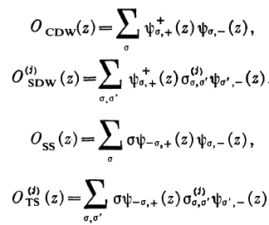
Typical types and order parameters of electronic symmetry breaking
Corresponding susceptibilities:
Phase diagram (PD) of a 3d system of weakly interacting chains is usually supposed to correspond to the conventional 1d PD being defined by divergences of corresponding susceptibilities at T→0.
Conditions β_{i}>0 with choosing the maximal one were giving rise to the PD in coordinates of many coupling constants of the 1D Hamiltonian which influence β_{i}

Slide 4
Typical picture of true phase transitions in quasi 1D systems: on top of T=0 divergences in 1D - interchain coupling of order parameter
Given an inter-chain coupling λ_{i} the total susceptibility yields
The unattended problem: 3d couplings λ_{i} do not appear explicitly (except for i = CDW) due to the loss of electronic coherence in the course of an interchain tunneling. λ may or rather cannot be generated from the interchain hopping Hamiltonian
z=x+it
Conventional systems: λ∝t²/Δ for SC or CDW, λ∝t²/U for AFM,SDW - gaps Δ or U are required to generate either Josephson or spin-exchange couplings

Slide 5
Gapless Tomonaga-Luttinger regime
, z=x+it, η_{F} =2-β_{F}
No interactions: η_{F} =1 ν=0, Attraction: γ>1, Repulsion: γ<1, Mott instability: γ<1/2
Expressions for χ_{1d} follow from K if we bind the ends z_{j} by pairs, e.g. for SC z₁=z₂,z₃=z₄, and integrate over them.
It was just the artificial confining of the ends that usually brought the optimistic result of reproducibility of χ_{1d} .
∫d²z
=χ

Slide 6
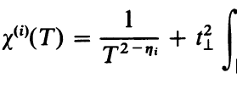
Series of t⊥=t for any χ:
f= f(u, v) depends on the symmetry lowering, otherwise f = const.
Regime 1: ∫d²w , w=u-v, is convergent, two particles tunnel together,
series of χ^{i}_{1d} is reproduced accumulating to divergent χ^{i}_{3d} .
Regime 2: divergence towards upper limit ∼1/T; series of χ^{i}_{1d} is not reproduced: independently on the channel (i), the series goes in powers with the non-specific index η_{F} of the one-particle Green function, apparently working out the quasi-1d band picture.

Slide 7
B) The integral over (u - v) converges at some length ξ.
The intermediate ends u, v (tunnelling space-time points) become confined at the scale ξ. Then, the subseries of powers (λ_{i}χ_{i})^{n}
with the effective coupling constant λ_{i} :

Slide 8
Brutal-force power law convergence of the sub-integral over w=u-v
In a common TL case with no gaps and symmetry lowering effects the convergence requires for 2η_{F}-η_{i}>2. Not excluded for extremely strong long range repulsions, but still so far: for free fermions 2η_{F}-η_{i} =0 @ γ=1!
Even for U →∞ Hubbard model: γ=1/2, η_{F} =9/4 , 2η_{F}-η_{i} =1/2<2
Here we need truly strong interaction, well beyond stability criteria, e.g. γ>1/2 for repulsion:
This consideration touches hot topics from all 1990’s of one- and two-particle inter-chain coherence of coupled TL chains
Bourbonnais&Caron; Clark,Strong&Anderson; Fabrizio et al; Finkelstaein&Larkin; Kusmartsev,Luther&Nersesyan; Mila&Poilblanc; H.Schultz; Tsvelik; Yakovenko

Slide 9
Symmetry lowering to the Mott state - the gap Δ in the charge channel. Or a singlet superconductivity or CDW - the gap Δ in the spin channel.
The convergence length ξ~1/Δ is worked out
Particles tunneling is confined – generalization of Josephson or exchange coulplings

Slide 10
“Imaginary correlation lengths” or virtual attractions from inequivalence of chains
Fortunate present from tiny structures of the Q-1D organic superconductors: alternating mean densities at neighboring chains (n)
i=SS, TS
Spin density waves under magnetic field H transverse to the inter-chain b direction - progressive increments of Fermi wave numbers among neighboring chains:
i=CDW, SDW

Slide 11
The oscillating factors greatly improve convergence
with
being the sufficient condition rather than ν>1
for super-strong interactions.
ν≠0 at any γ≠1 – already for small interactions.
The confinement within the tunneling pair is maintained,
effective interchain coupling constant is worked out

Slide 12
Outcome: Interchain mismatches κ,q of wave numbers work as imaginary gaps, 1/κ,1/q work as imaginary correlation lengths of e-e or e-h pairs.
Having found , after tunnelings, themselves both away from the Fermi points, the particles get confined, keep coherence, and transmit on-chain divergences of pair-wise correlation functions.
Methodological hint for these observations:
A lesson from the diagram technique epoch – always check for cumbersome higher order diagrams, above the happily found seemingly significant ones.
An advice hardly realizable in earlier time of decoupling techniques and the later RG epoch.

